Slide 1

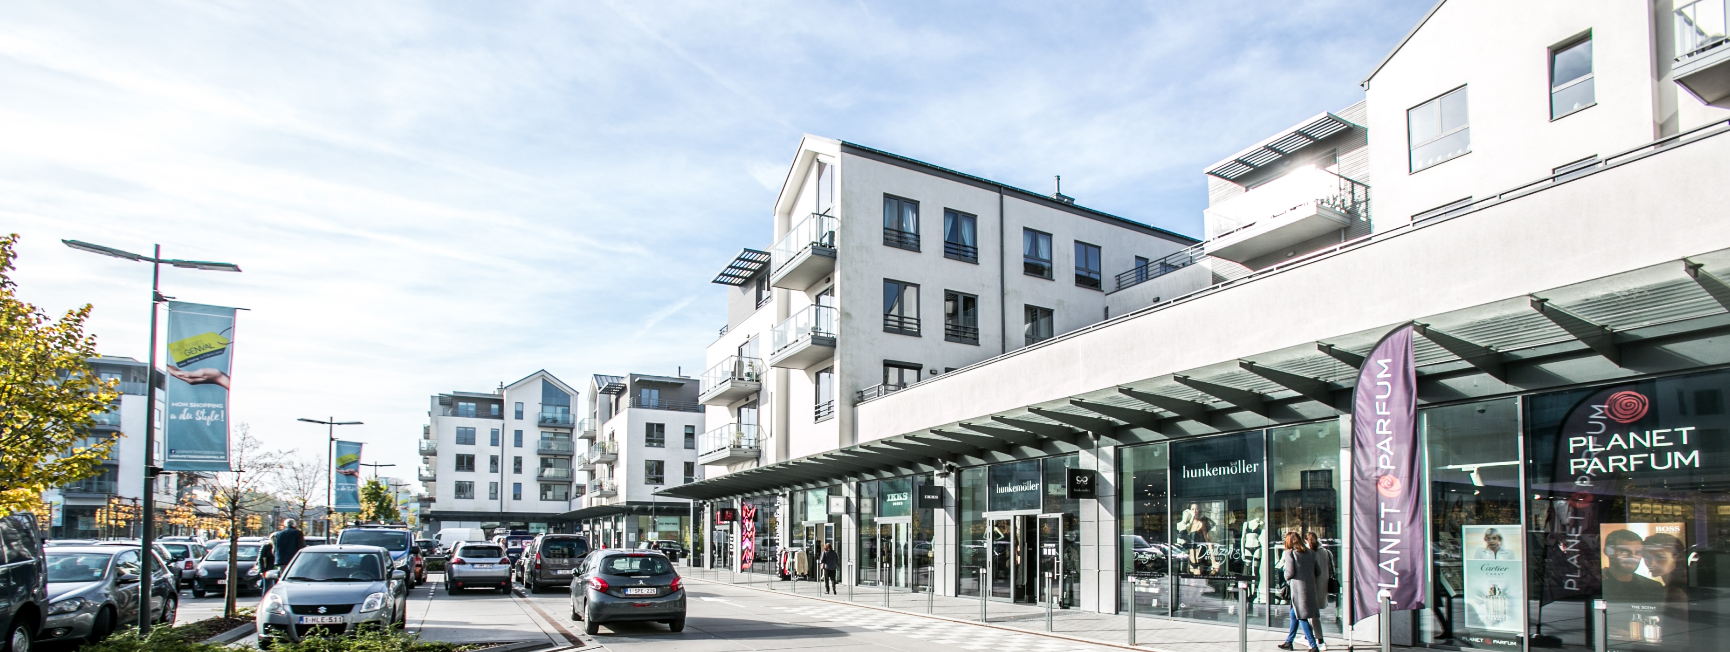
KBC Real Estate Conference – 21 March 2019

Slide 2
Agenda
Ascencio in a nutshell
Overview 2017/2018
Real estate portfolio
Results
Financing structure
Data per share
Strategy
Appendix

Slide 3
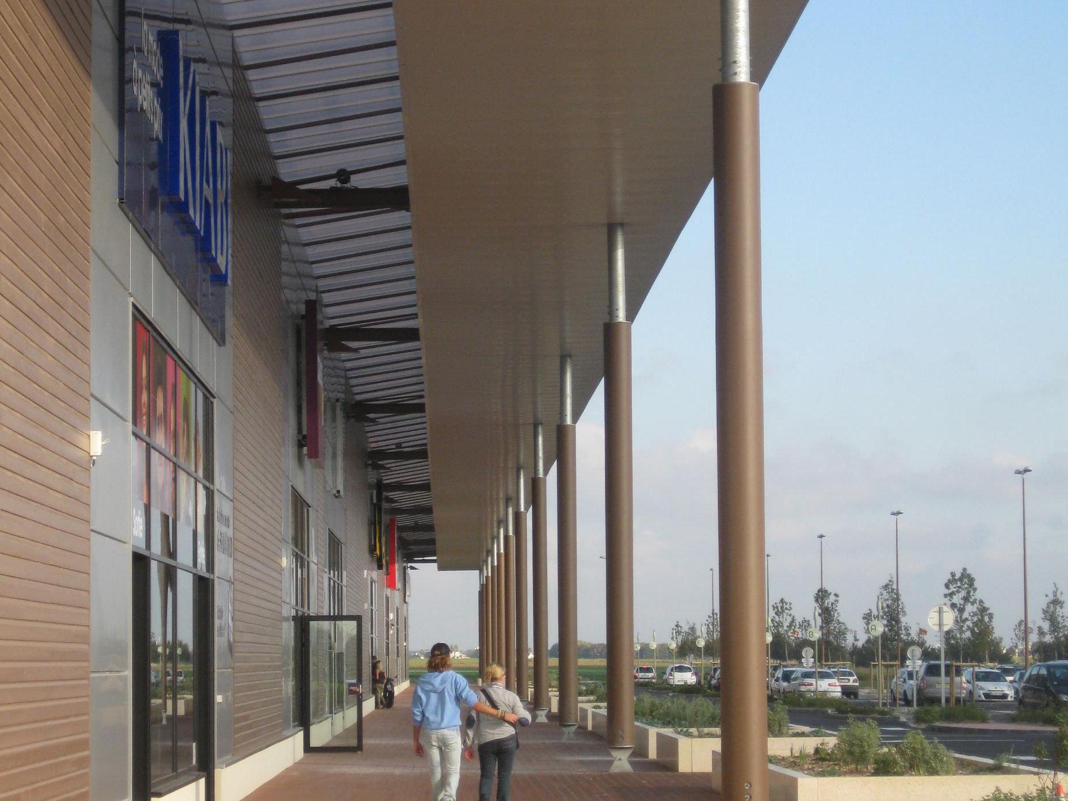
ASCENCIO IN A NUTSHELL

Slide 4





Ascencio in a nutshell
RETAIL
Pure player in periphery retail
Strong presence in resilient food sector (> 30%)
High occupancy (> 97%)
Rental income (41 MEUR)
GROWTH
From 170 to 624 M EUR in 11 years
Room for investment (70 MEUR)
FINANCIALLY ATTRACTIVE
Belgian REIT
Limited debt ratio (40,0%)
Declining cost of debt (2,04%)
Low pay-out ratio (84%)
DIVERSIFICATION
Over 300 tenants in 103 buildings
Belgium, France and Spain
Portfolio : 624 MEUR on 31/12/2018
Gross yield > 6%

Slide 5
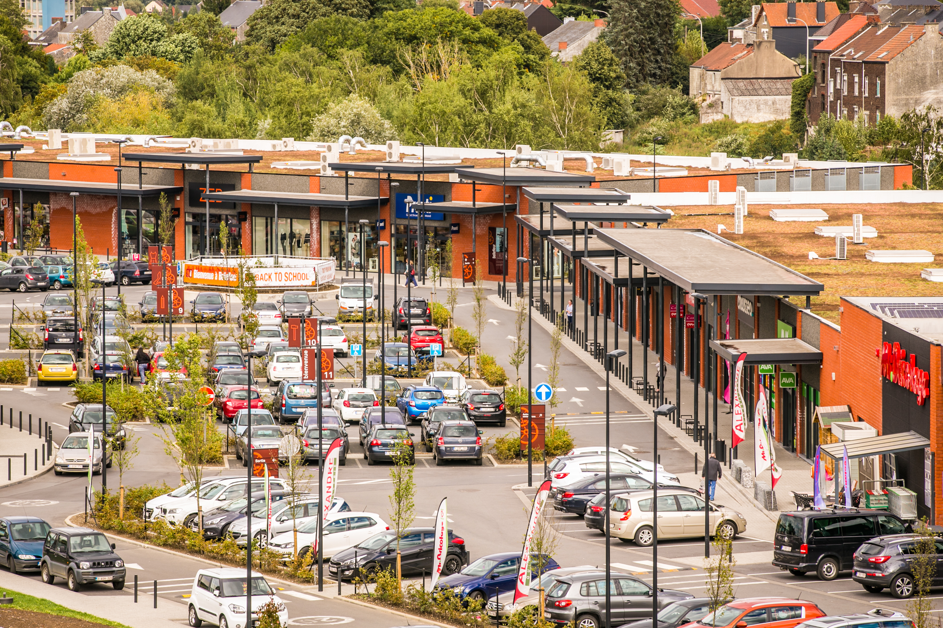
OVERVIEW 2017/2018

Slide 6

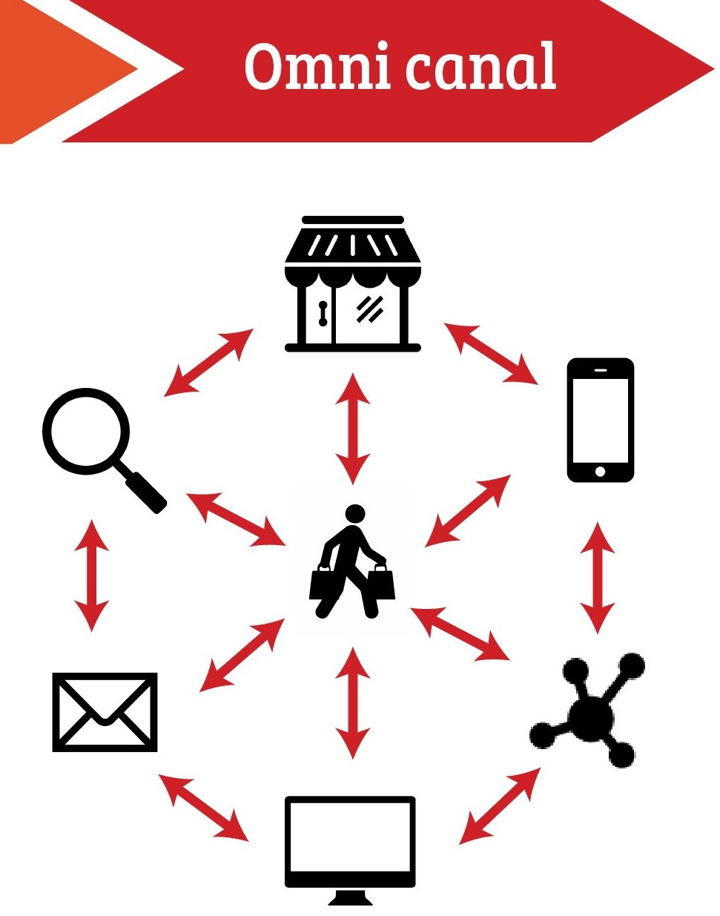
Outcome 2017 - 2018
A difficult year for the retailers
E-commerce & omnicanality
Change in the consumer’s profile
Change in the retailers’ business model

Slide 7
Outcome 2017 - 2018
2. Impact on the financial and investment markets
The concerns of the financial markets about retail do impact the market price of the real estate investments companies
Complex investment market : few quality assets in periphery retail for sale, priced at very low yields

Slide 8
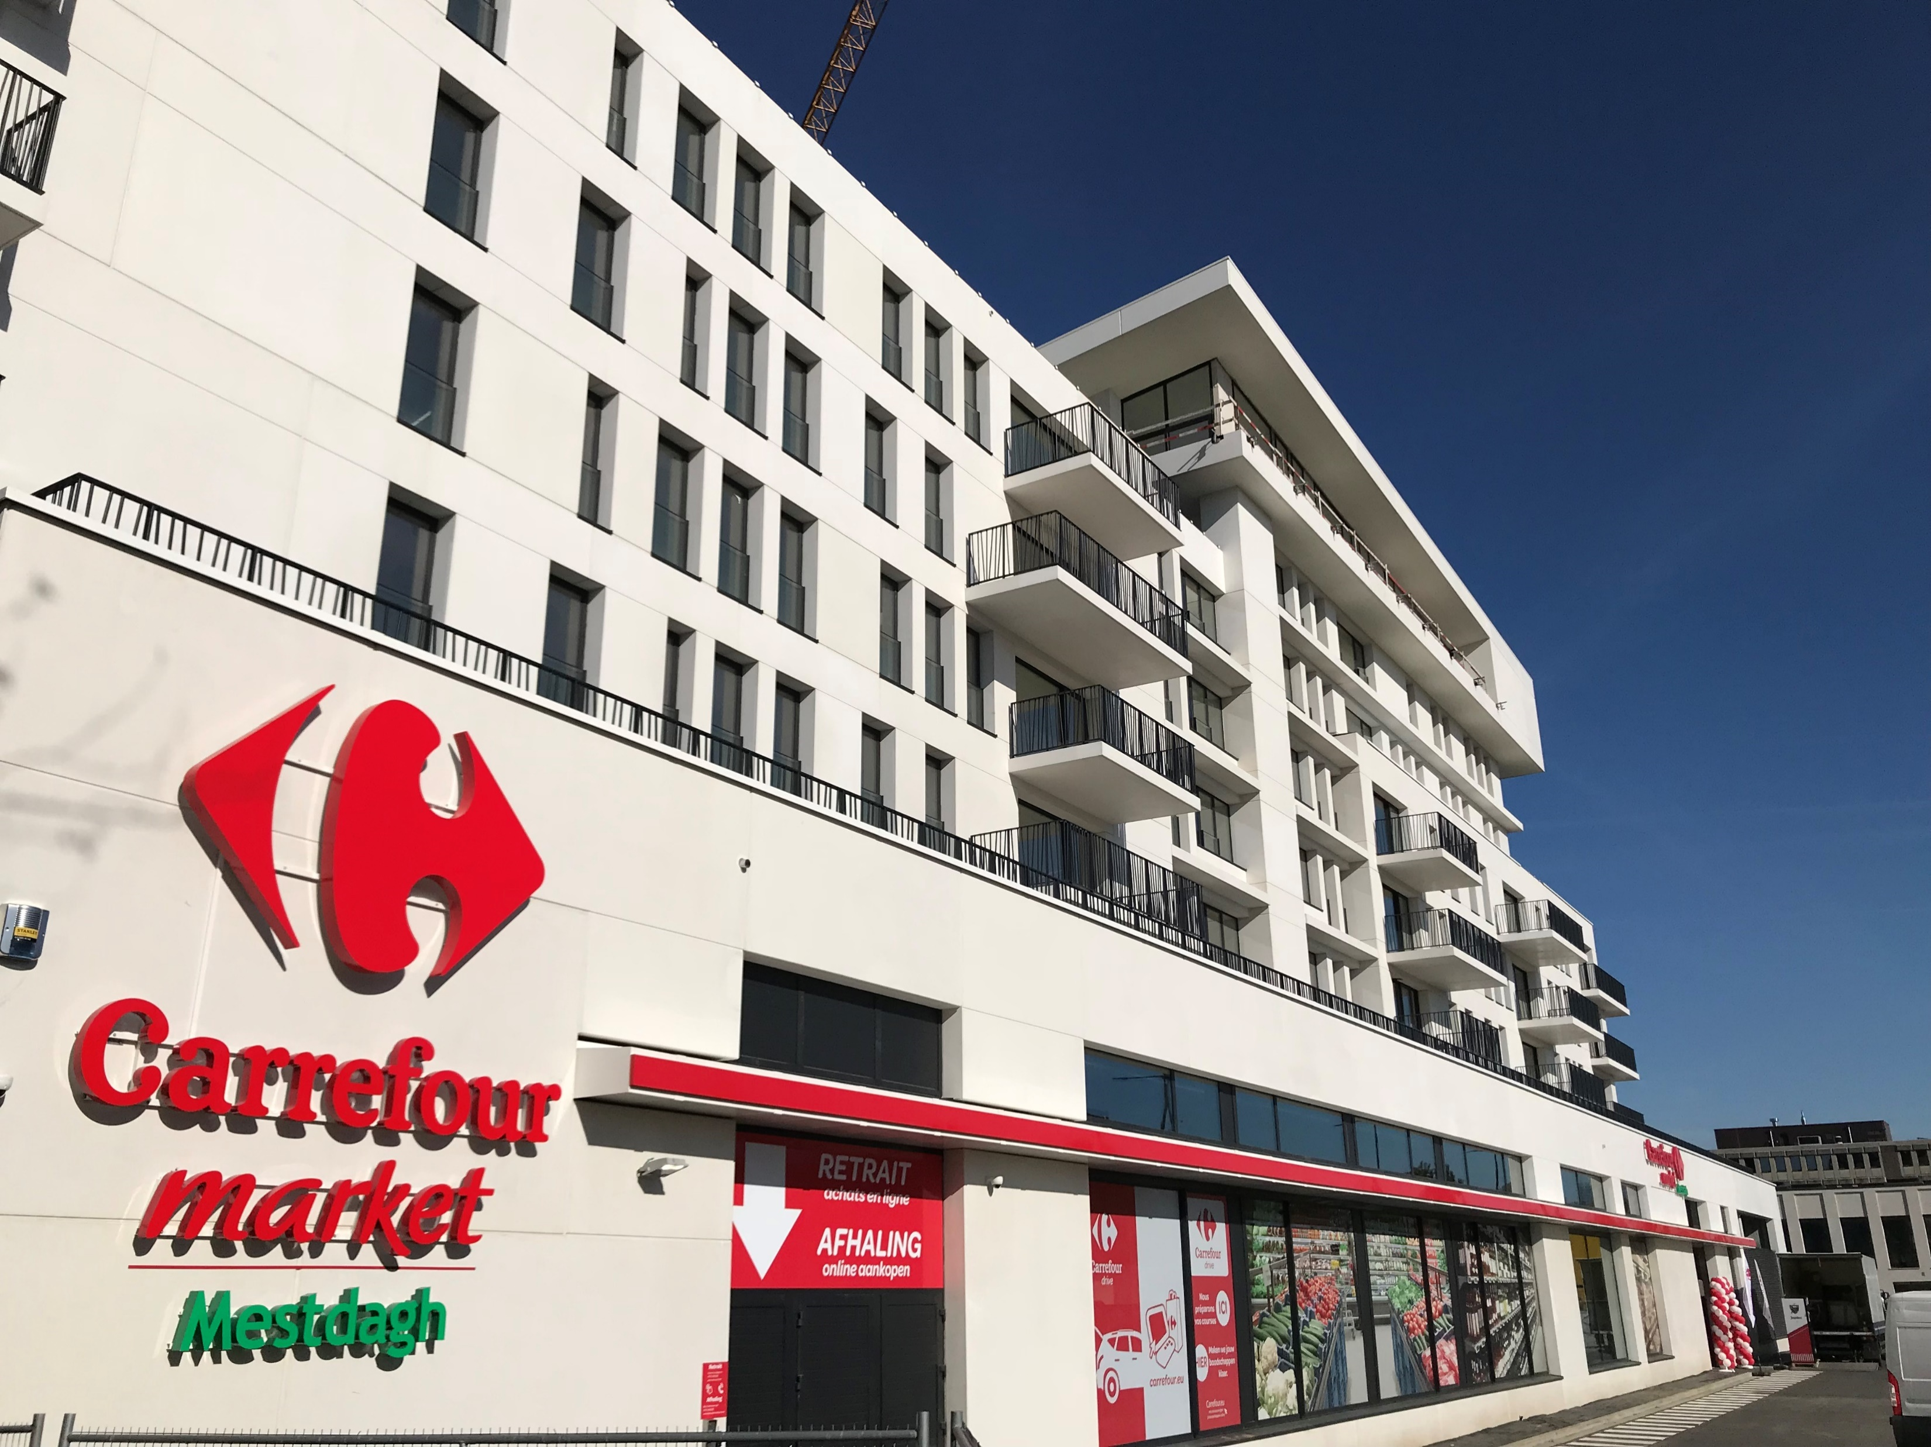

Highlights: a great year for Ascencio
Highlights 2017/2018
Acquisitions/disposals
Overijse (-) ; Anderlecht (+)
EPRA Gold Award
New analyst: F. Renard (Kepler Chevreux)
Decrease of financial charges
Non-recurring costs (Amsterdam)

Slide 9
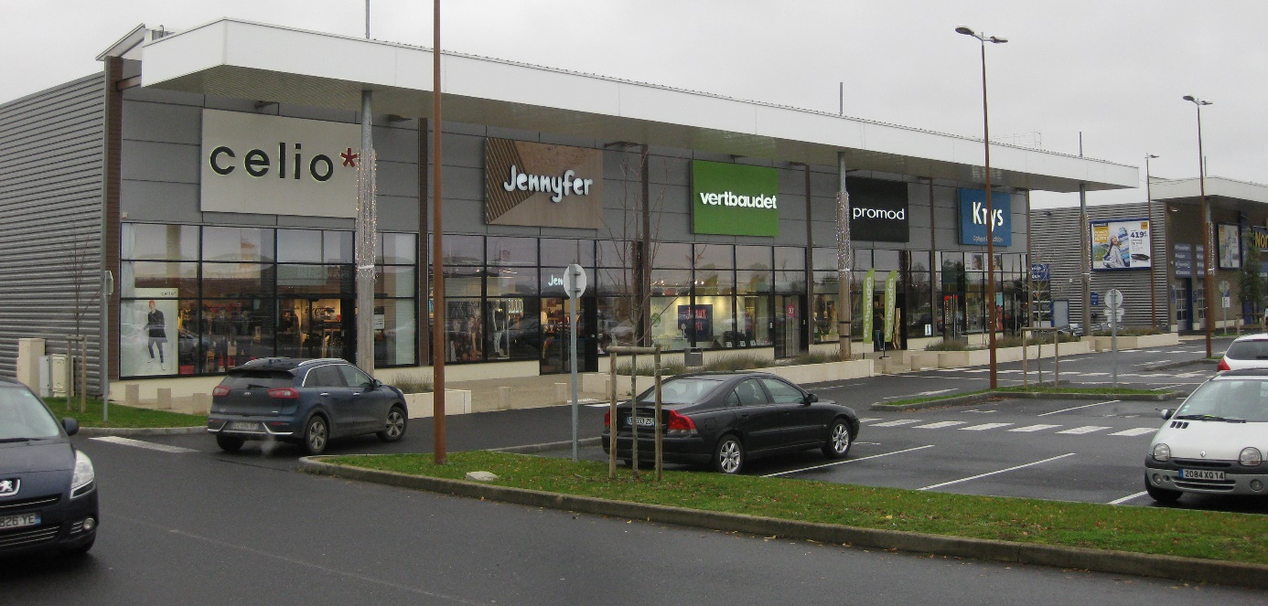
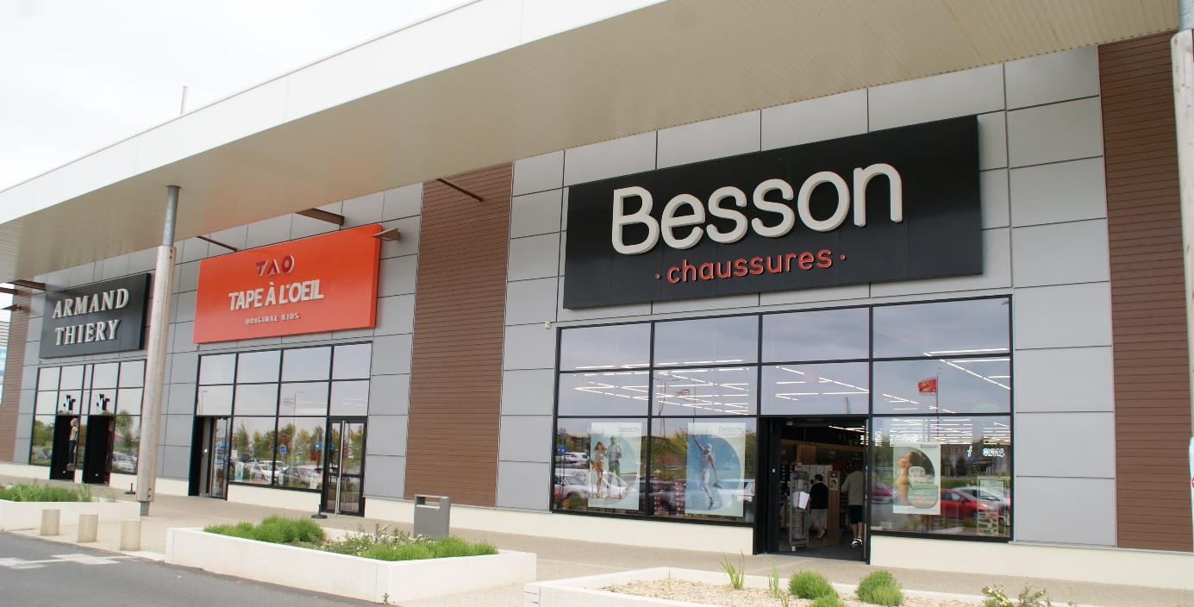
Highlights: a great year for Ascencio
Highlights post 2017/2018
Acquisitions/disposals
Le Pontet (-) ; Caen Rots (+)
EPRA Index
New analyst: J. Opdecam (KBC Securities)

Slide 10
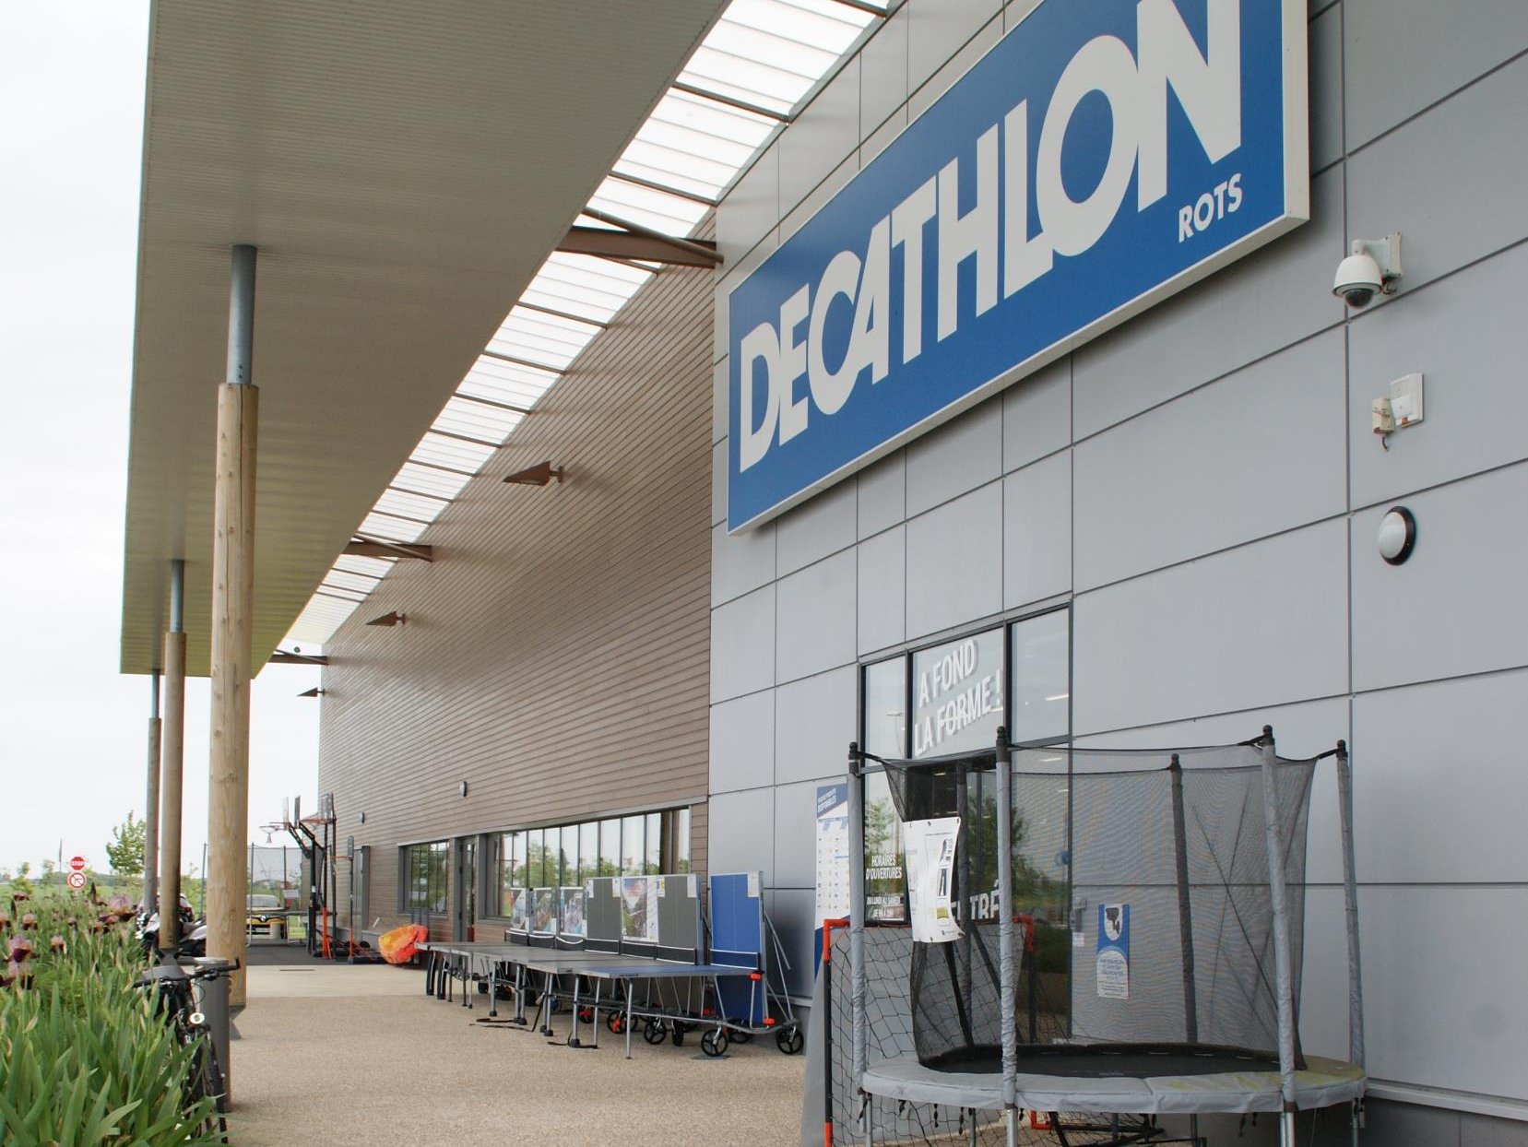
REAL ESTATE PORTFOLIO

Slide 11
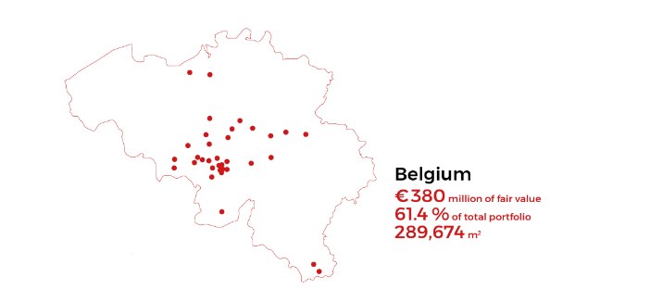
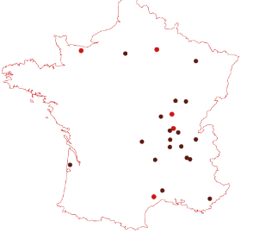
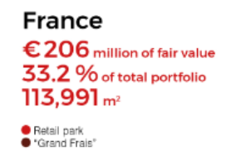
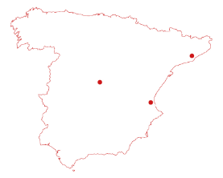

Real Estate Portfolio (30/09/2018)
Diversification by type:
Diversification by sector:
Retail park: Open-air commercial complex including at least 5 renting units for a global GLA > 3.000 m^{2.} Retail properties that form part of an integrated commercial complex and are grouped together with other retail properties. All properties use a central car park with a shared entrance and exit road.
Retail cluster: A collection of peripheral retail properties, located along the same traffic axis and, from the consumer’s point of view, they form a self-contained whole, although they do not possess a joint infrastructure other than the traffic axis.

Slide 12
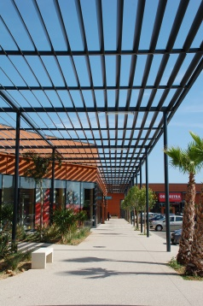
Real Estate Portfolio (30/09/2018)
Secure Rental Revenues:
Occupancy rate : 97,3%
Affordable Average Rent :
Belgium : 92 EUR/m²
France : 123 EUR/m²
Spain : 161 EUR/m²
Low unpaid rents : 0,25 %
(last 5 FY average)

Slide 13
Real Estate Portfolio (30/09/2018)
Key figures :

Slide 14











Real Estate Portfolio (30/09/2018)
Good tenants diversification :
Top 10 tenants:
High profile (inter)national brands :

Slide 15

Real Estate Portfolio (30/09/2018)
Food sector : 34% of rental revenues
GRAND FRAIS 11,8%
18 stores (out of 213)
^{1st} preferred brand in France 2018
MESTDAGH 10,3%
25 stores (out of 83)
Commercial partnership with Carrefour
Continuous growth since inception
Restructuring plan but no store closing
CARREFOUR 7,0%
12 stores « Market » (out of 430)
Restructuring plan focused on hypermarkets
No hypermarket in Ascencio Portfolio
OTHERS 4,9%
3 Delhaize 2 Aldi 1 Lidl

Slide 16
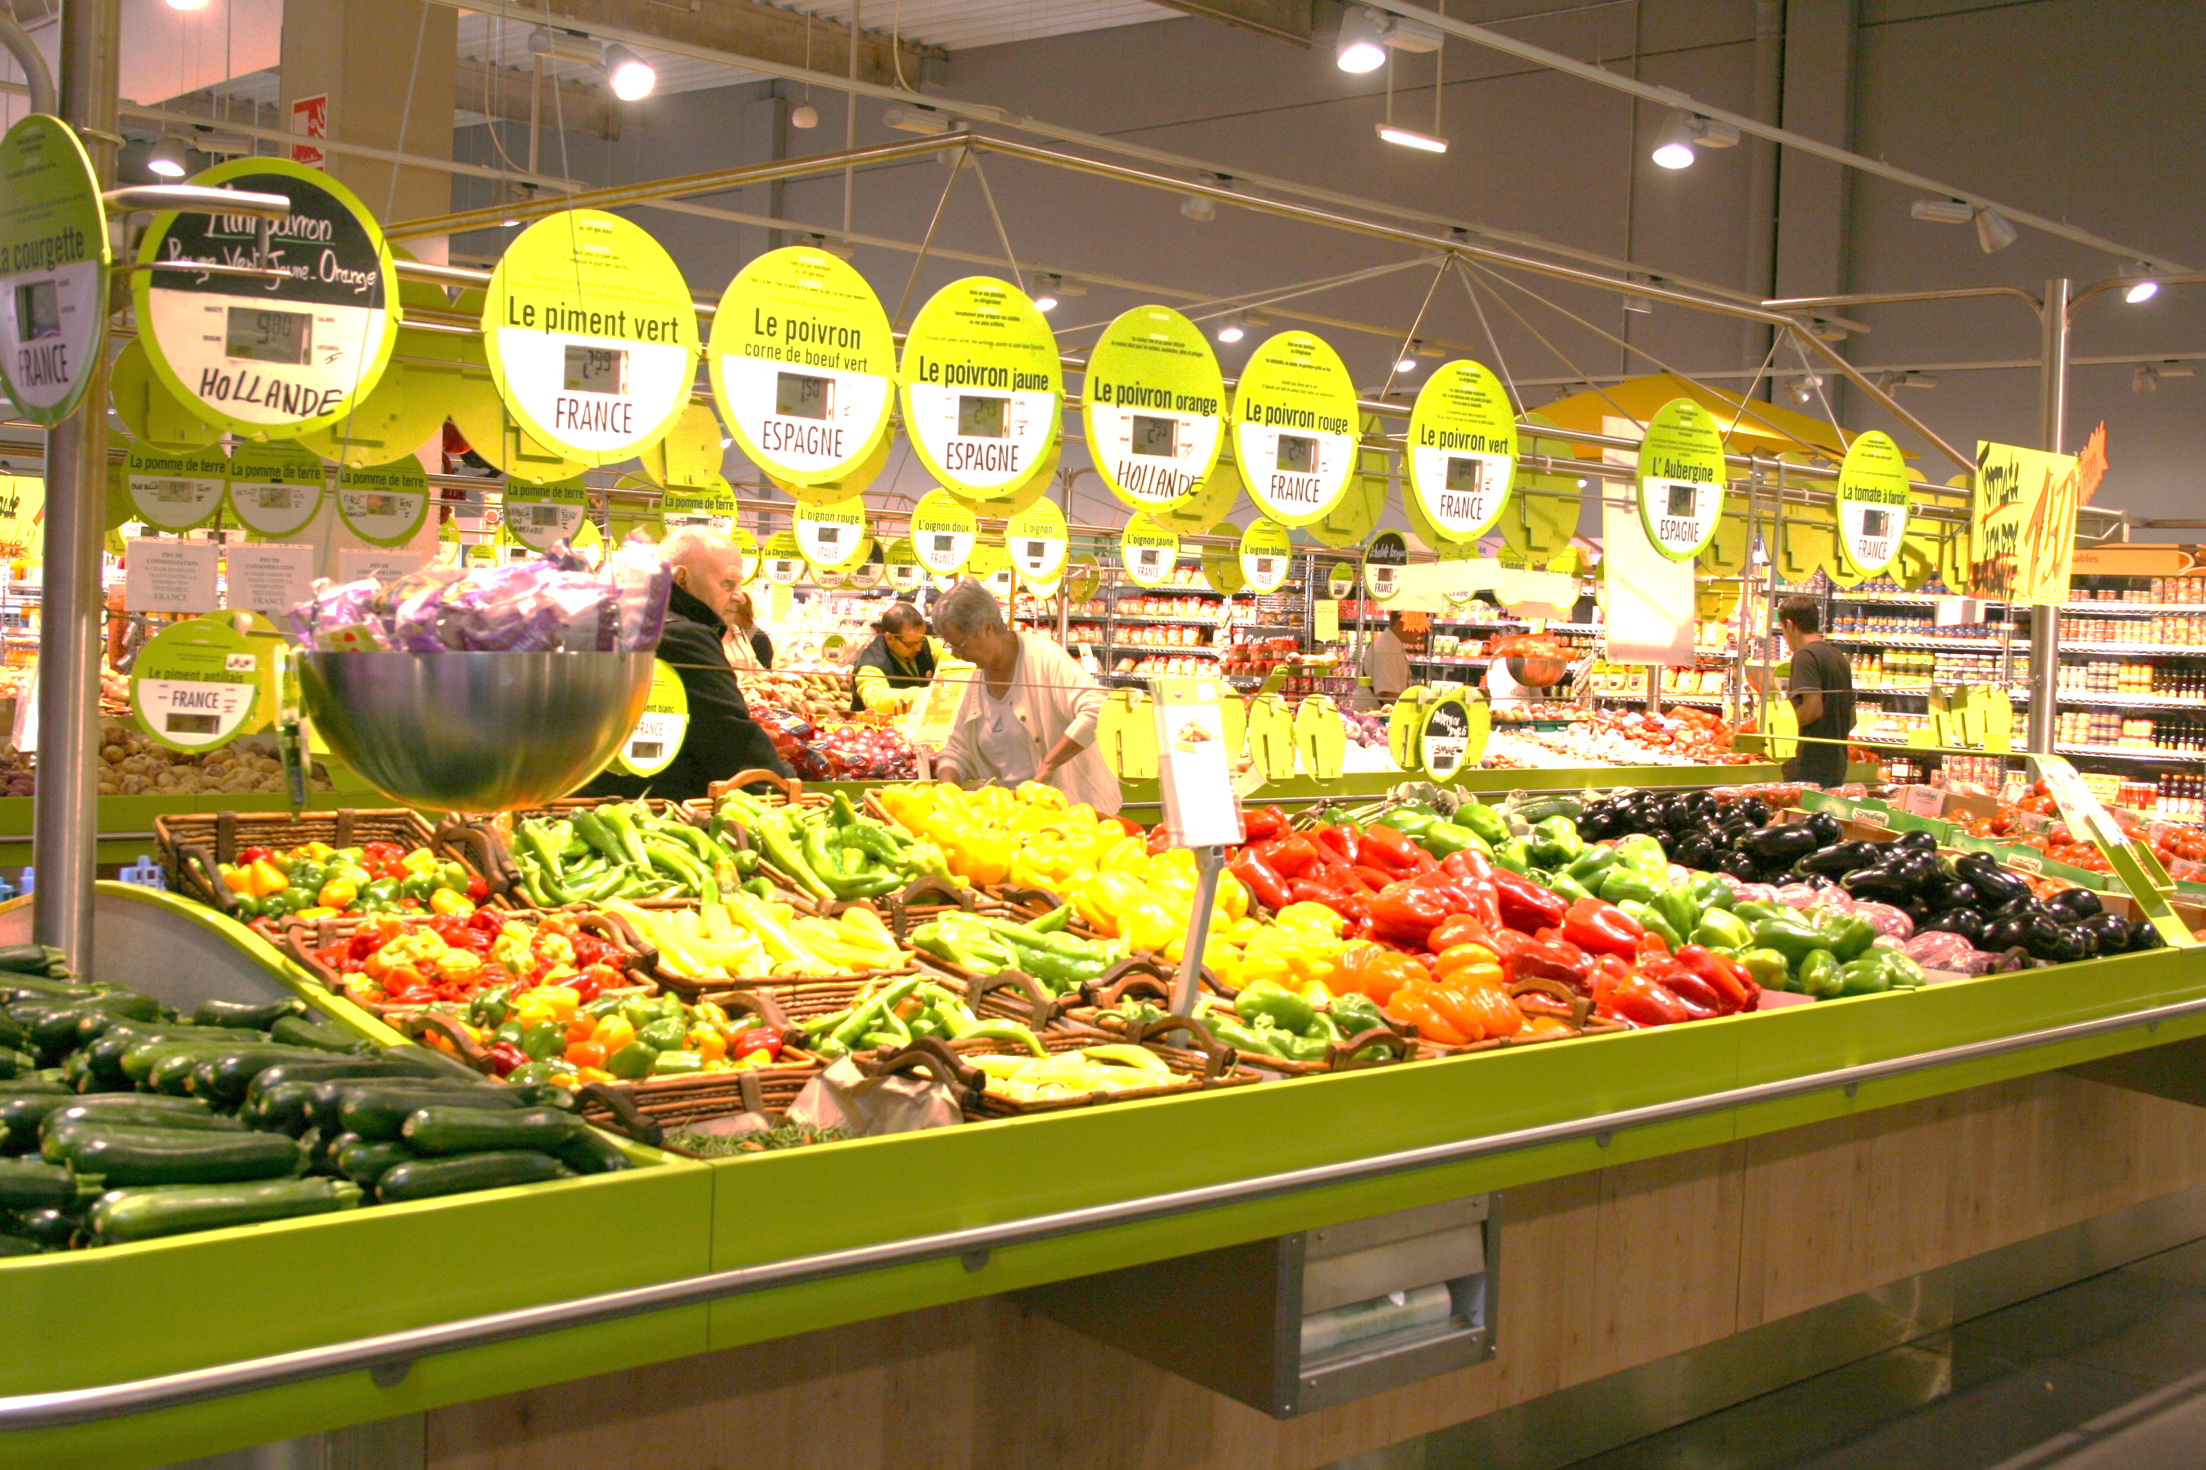
Real Estate Portfolio (30/09/2018)
Food sector : Defensive & resilient
Consumers’ basic needs
Good locations
Limited
e-commerce competition
Non-cyclical sector

Slide 17
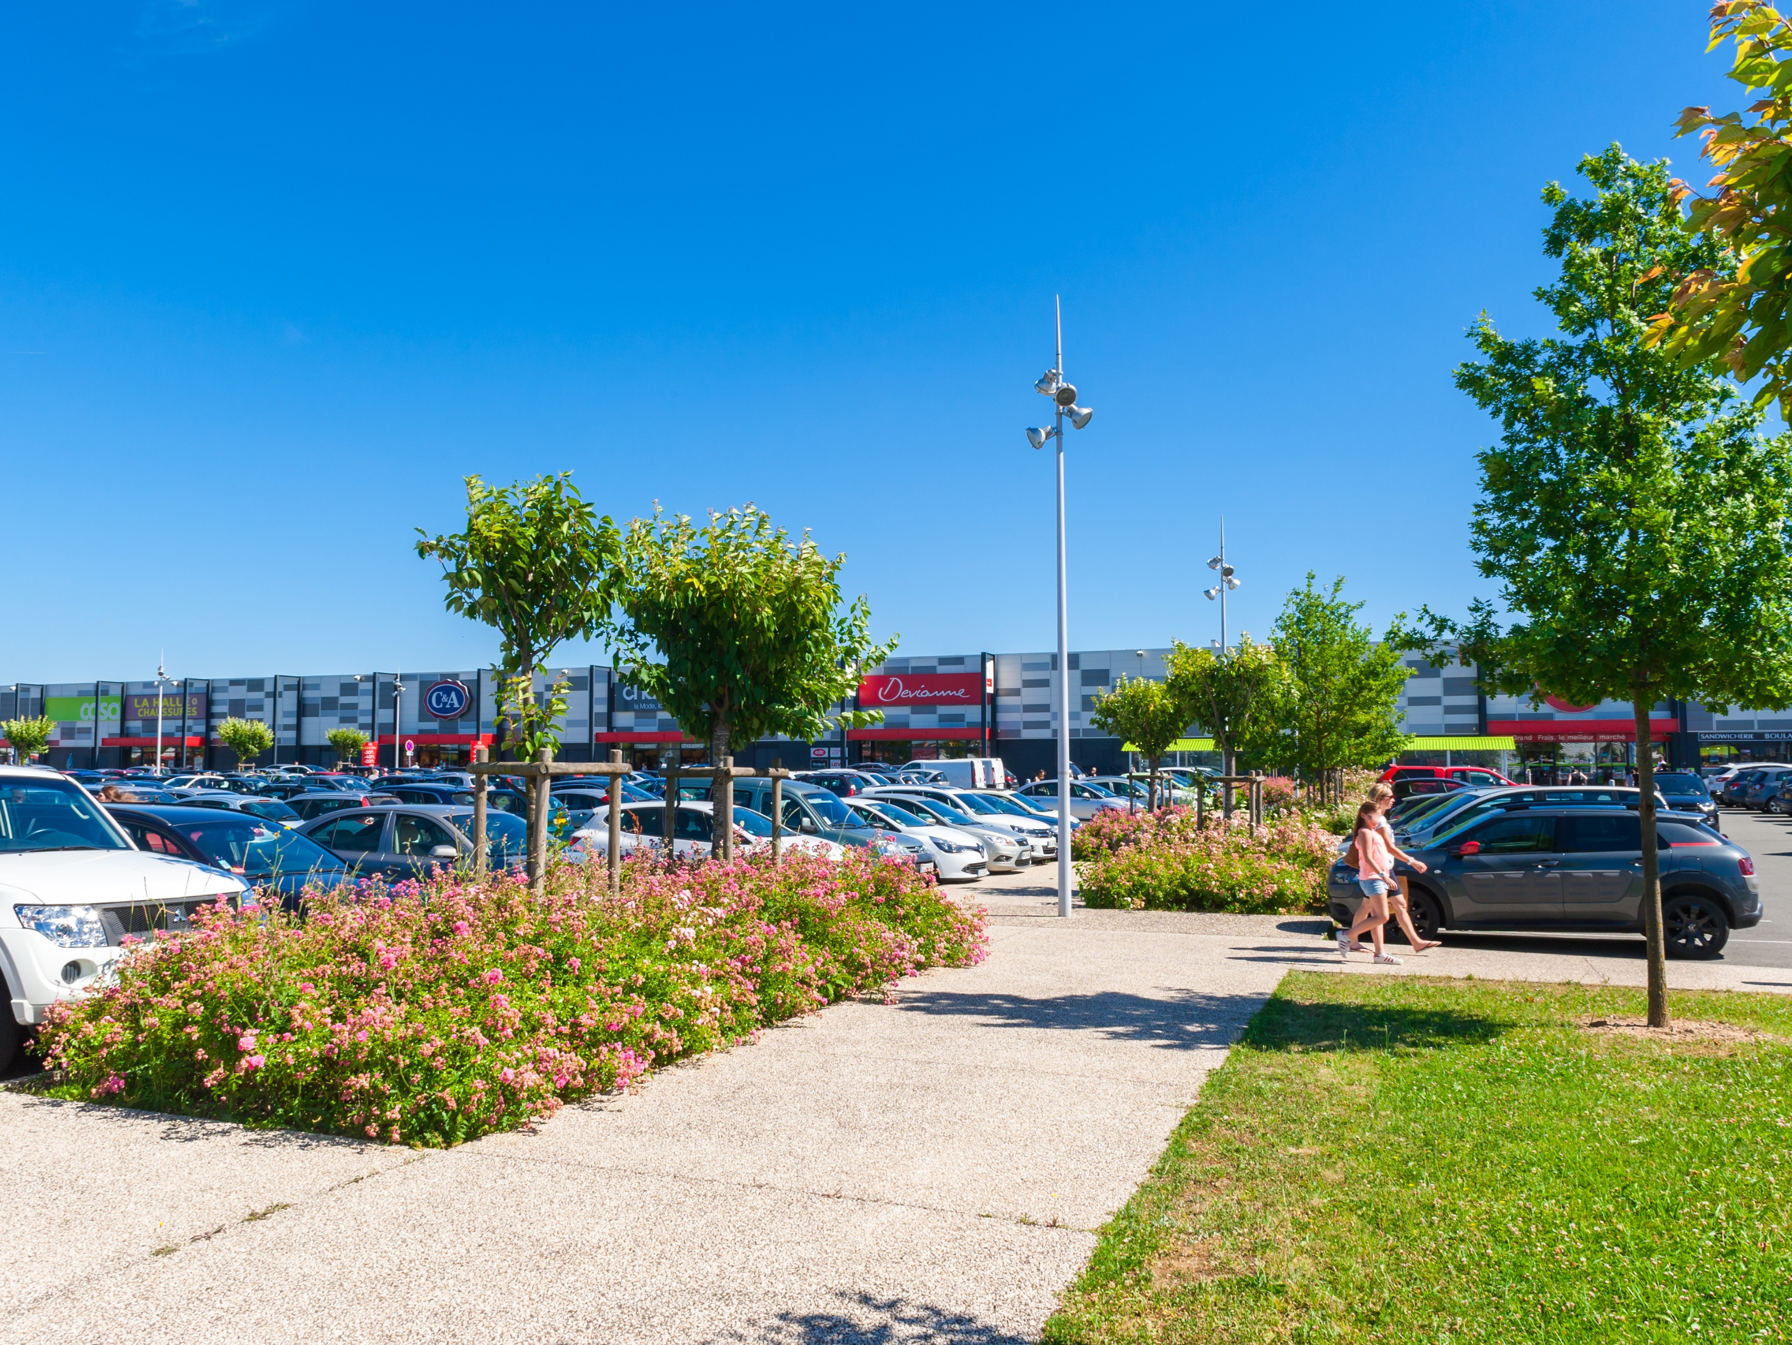
RESULTS

Slide 18
Results
Key figures :
For the detailed B/S and P&L: see appendix

Slide 19
Results
Rental income:

Slide 20
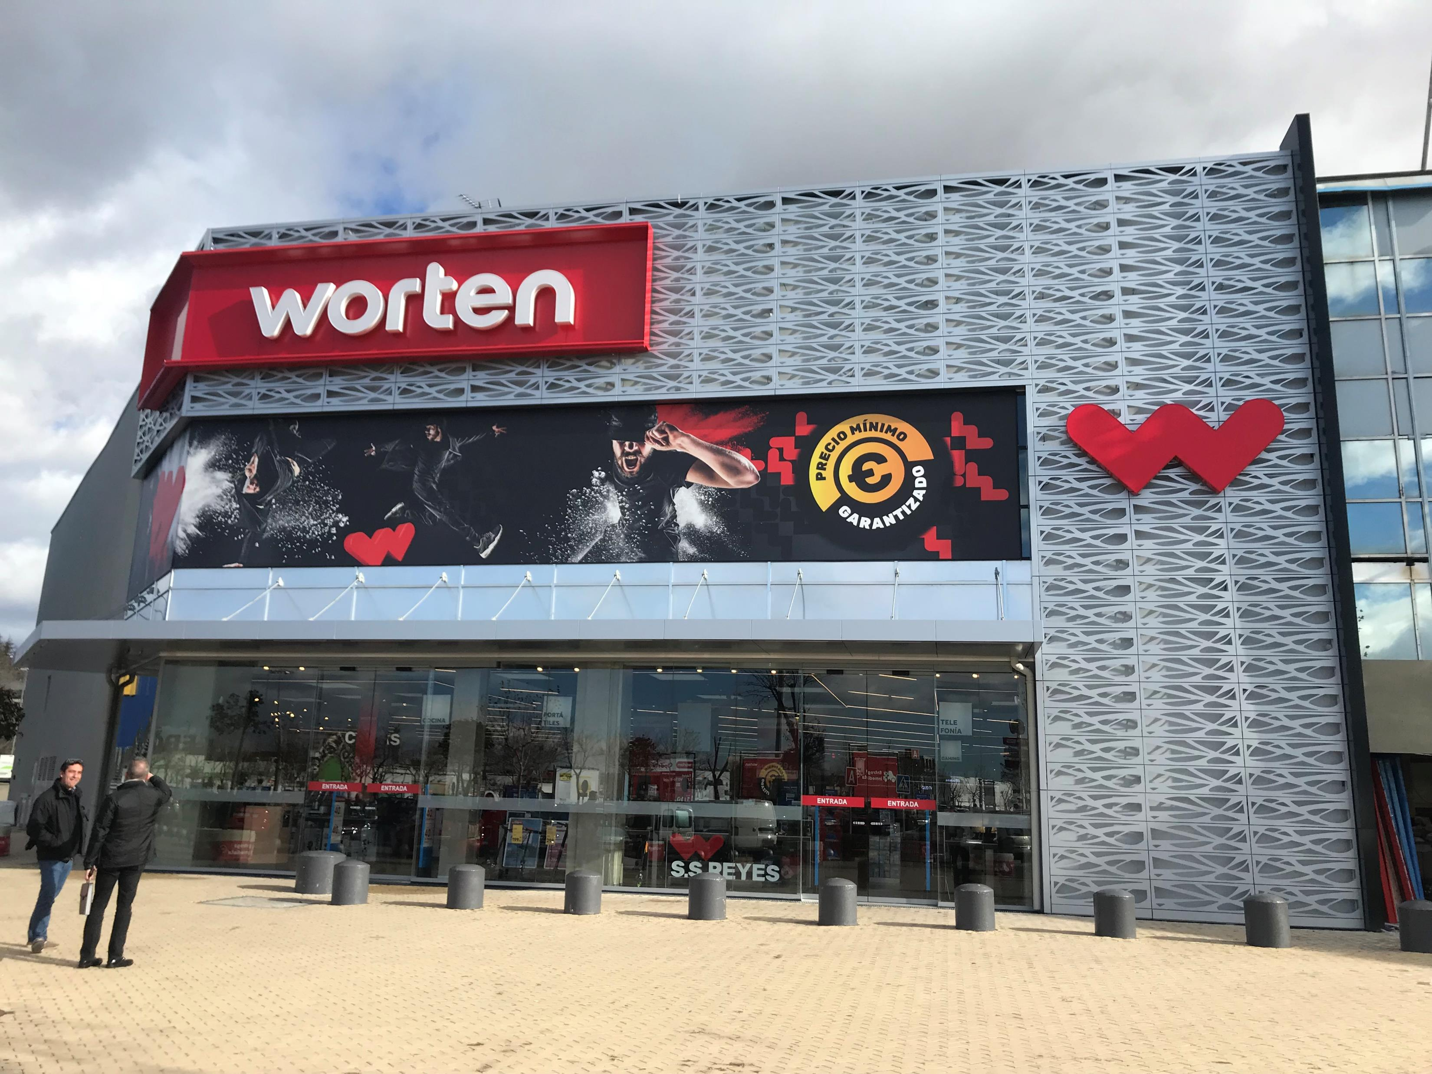
FINANCING STRUCTURE

Slide 21
Financing structure
Key figures:

Slide 22
Financing structure
Sources of financing :
Revolving credits maturity:

Slide 23
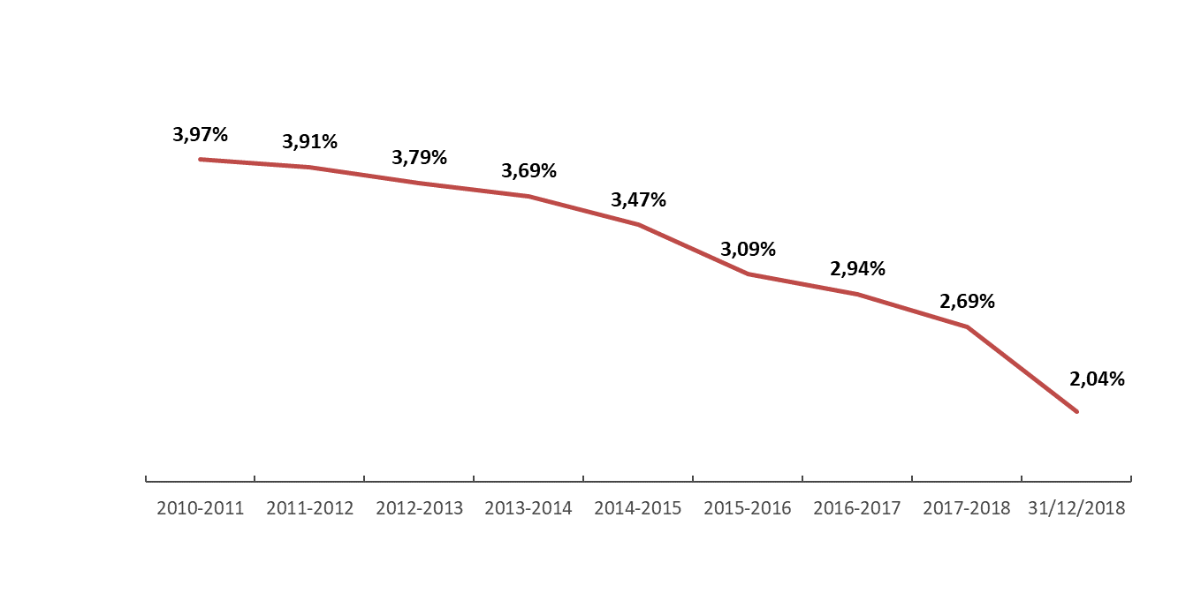
Financing structure
Average cost of debt (%)

Slide 24
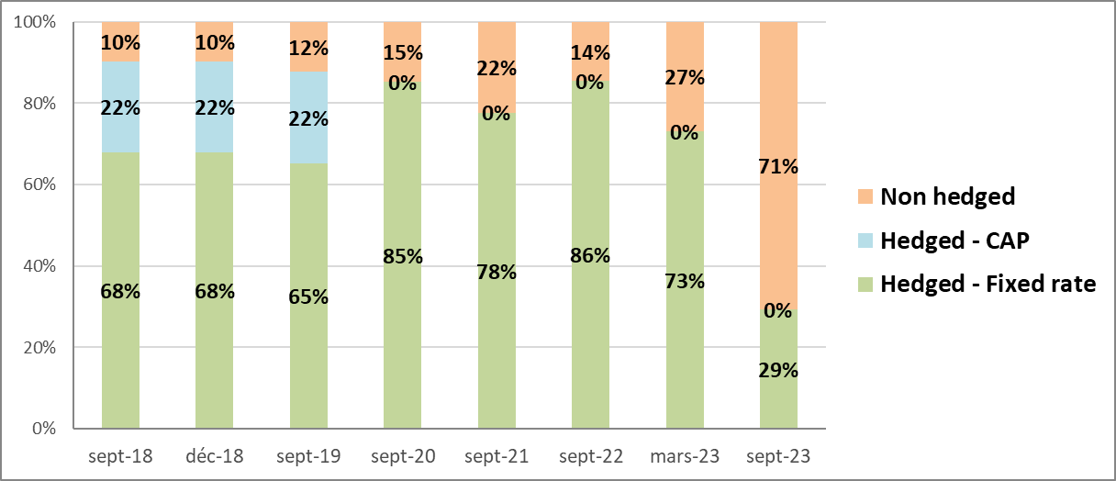
Financing structure
Hedging policy

Slide 25
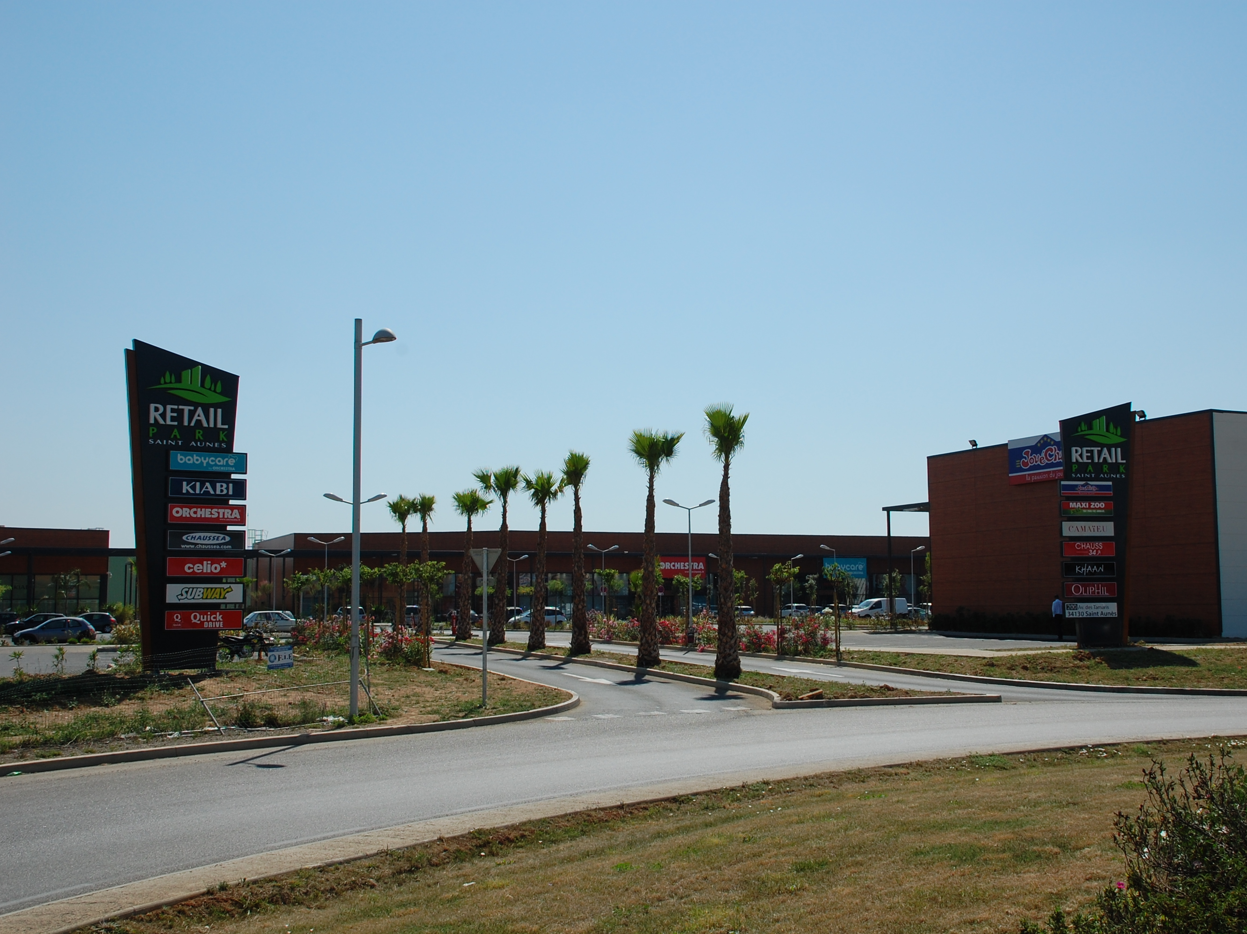
DATA PER SHARE

Slide 26
Data per share

Slide 27
Data per share

Slide 28
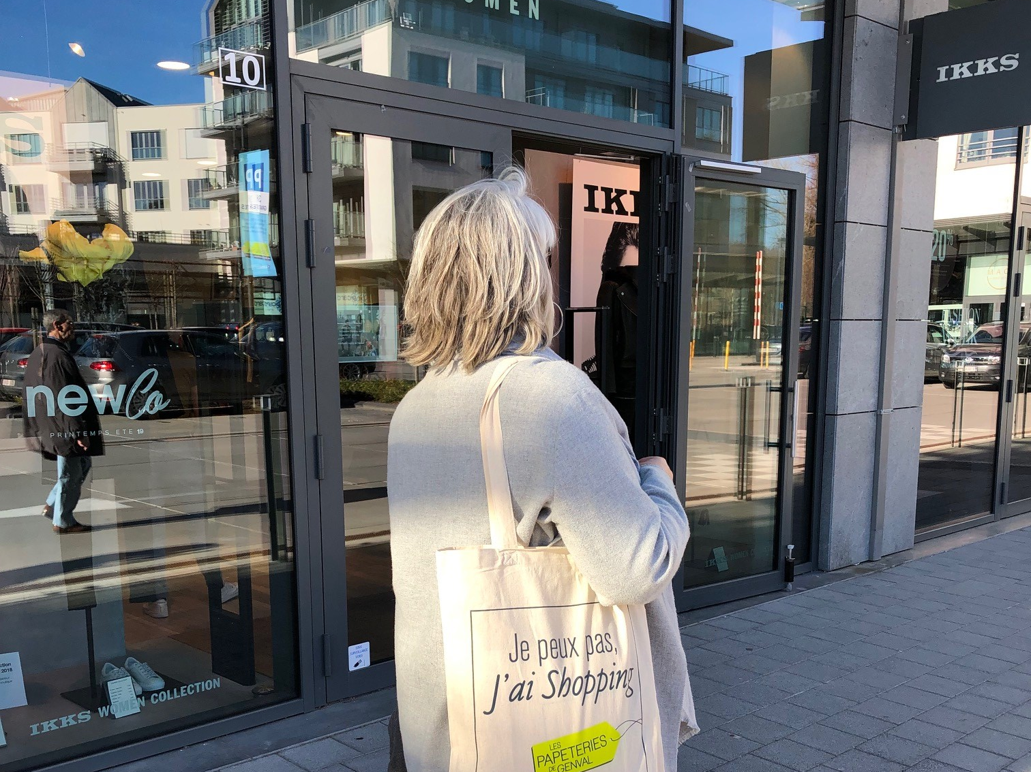
ASCENCIO STRATEGY

Slide 29




Ascencio strategy
Target investments
  Retail Park out-of-town
  Stand Alone with top location
  Structured urban retail complex
Sectorial diversification
  Optimization of the commercial mix
  Focus on food sector
  Progressive inclusion of entertainment experience
  Collecting digital data on site
Risk
  Core
  Core +
  Ad. Value

Slide 30
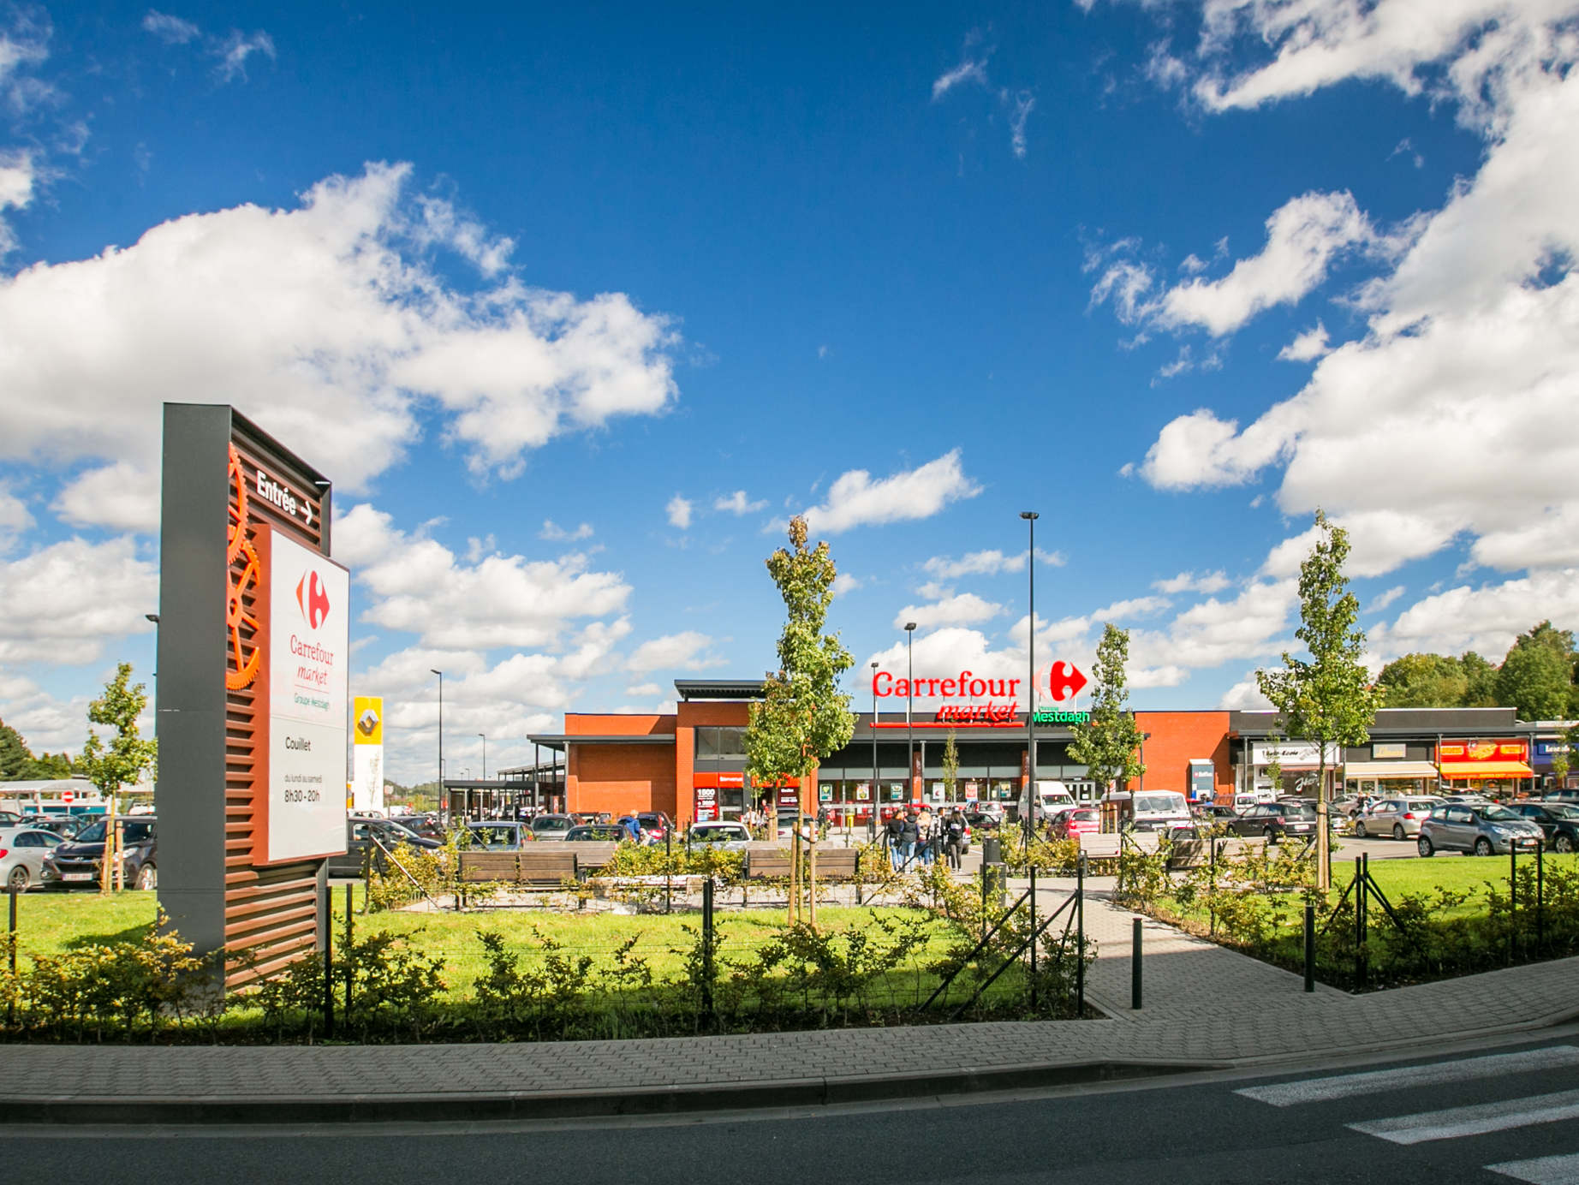
APPENDIX

Slide 31
Appendix
EPRA KPI

Slide 32
Appendix
Porfolio - Breakdown per country :

Slide 33
Appendix
Consolidated financial statements

Slide 34
Appendix
Consolidated financial statements

Slide 35
Thank you for your time
Any questions ?

