Slide 1
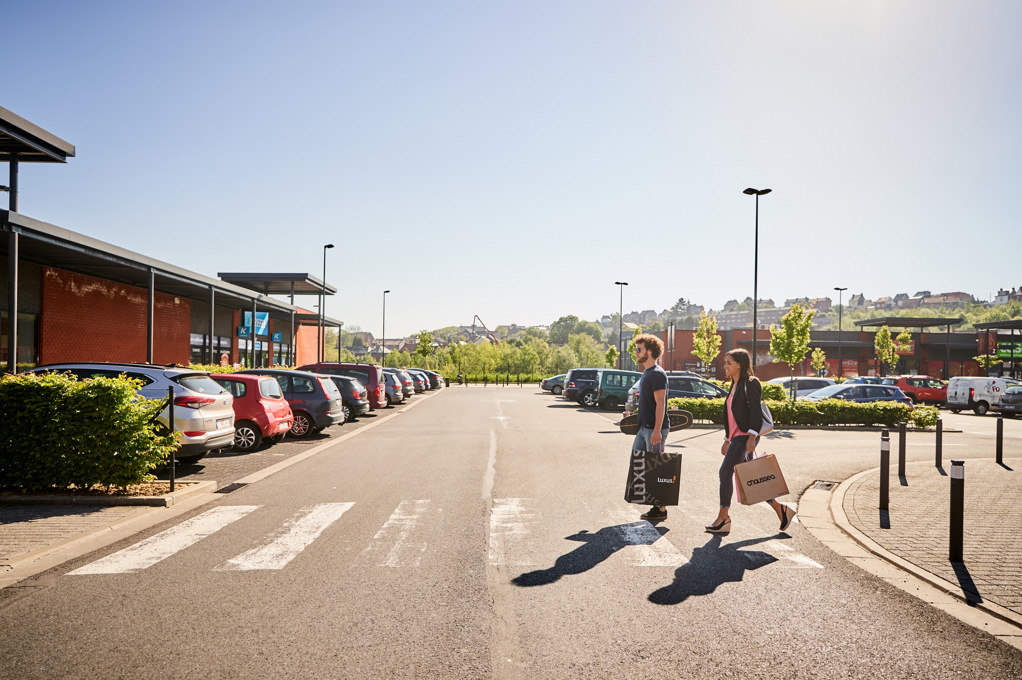
DEGROOF PETERCAM
-
Real Estate Seminar
September 2019

Slide 2
We invest in out of town retail real estate While beeing connected to our clients, our team and our markets. With the ambition to grow, following the market cycles. With « positive mind » as key word.
„

Slide 3
Agenda
Ascencio in a nutshell
p. 4
p. 4
Strategy
p. 6
Real Estate Portfolio
p. 7
Financing Structure
p. 13
Data per share
p. 14

Slide 4
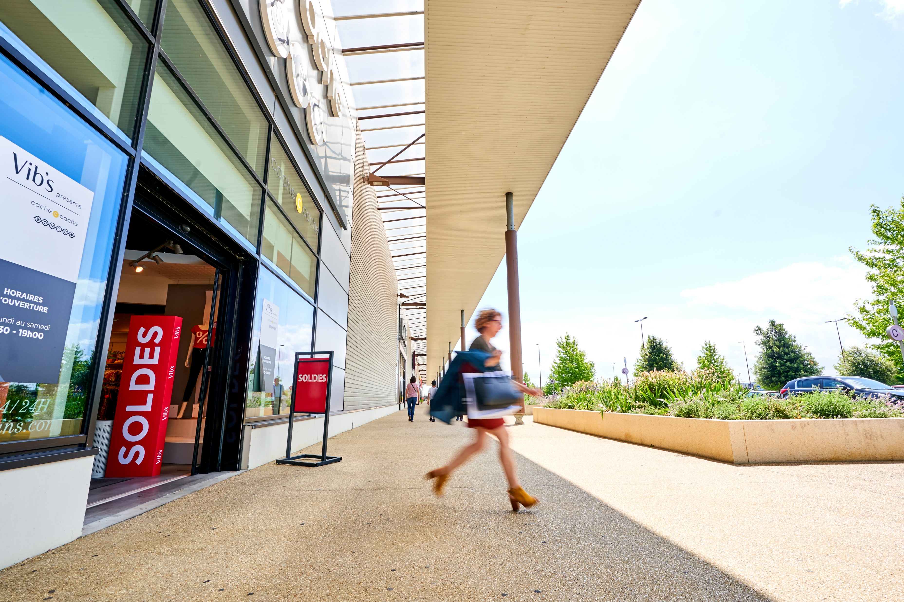
Ascencio in a nutshell
„
We are resilient
102 buildings
Belgium, France & Spain
A dozen of activity sectors – dominance of the food sector (>30%)
Market capitalisation : 376 KEUR

Slide 5
A dividend offering an attractive yield (> 6%) for investors
A small & agile team
EPRA Index
Challenges in the retail sector

Slide 6
Ascencio Strategy
Target investments
Retail Park out-of-town
Stand alone with top location
Structures urban retail complex
Sectorial diversification
Optimization of the commercial mix
Focus on food sector
Progressive inclusion of entertainment experience
Collecting digital data on site
Risk
Core
Core +
Ad. Value

Slide 7
Real Estate Portfolio Key figures at 30/06/2019
Fair Value
Passing Rents
Occupancy Rate
Gross Yield
623 MEUR
42 MEUR
96,6%
6,5%

Slide 8
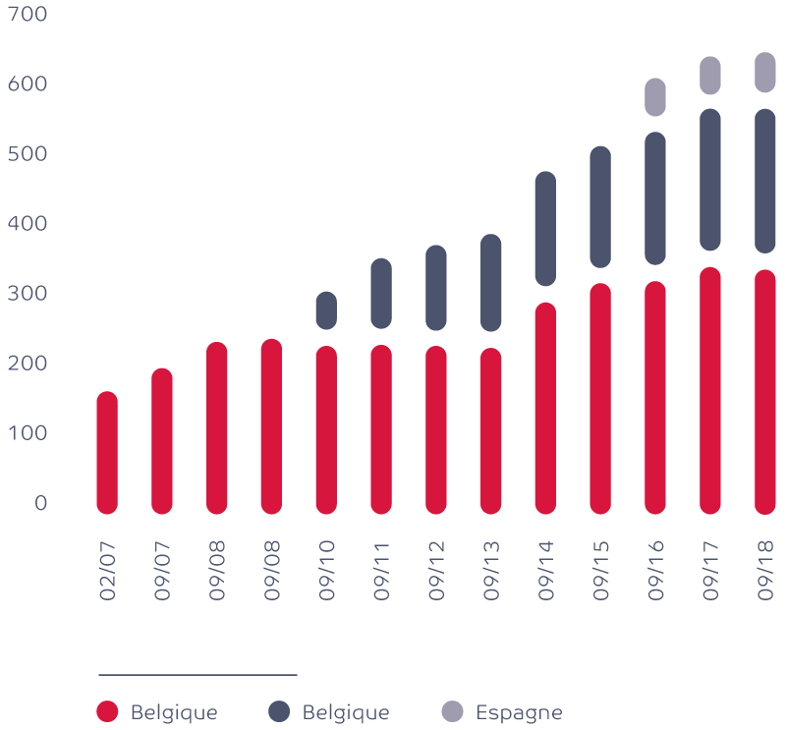
Real Estate Portfolio Growth
Room for investment (70MEUR)
„

Slide 9
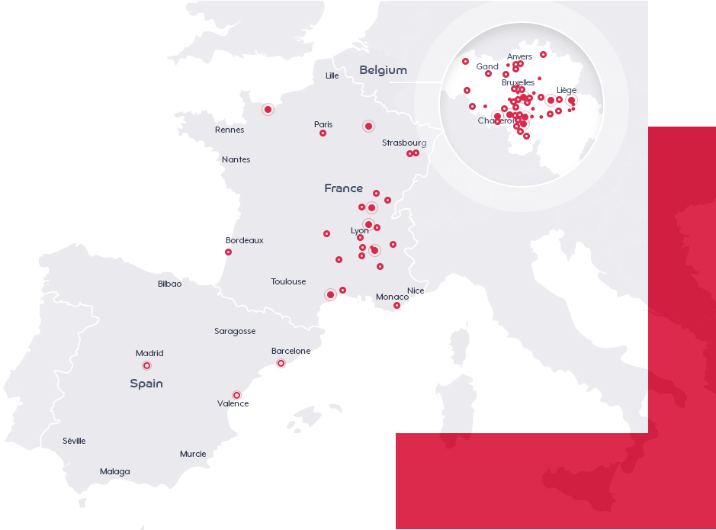
Real Estate Portfolio
Geographical diversification
Belgium
€377 million of fair value
61 % of total portfolio
289,674 m2
France
€213 million of fair value
34 % of total portfolio
113,991 m2
Spain
€33 million of fair value
5 % of total portfolio
12,253 m2

Slide 10
Real Estate Portfolio
Diversification by type & by sector (at 31/03/2019)

Slide 11
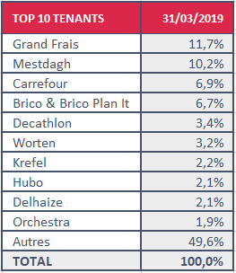
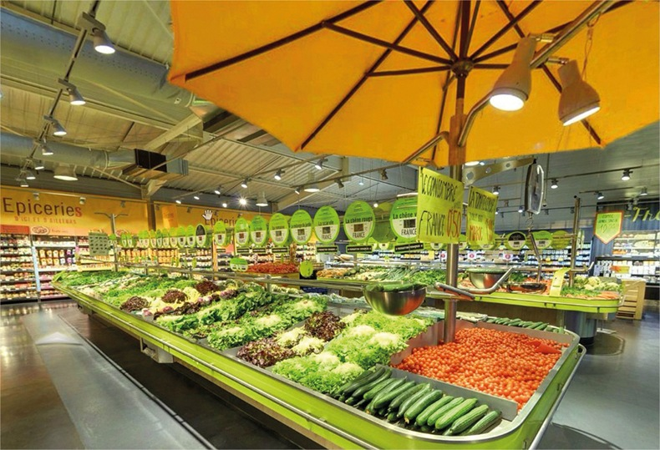
Real Estate Portfolio
Top 10 tenants

Slide 12
Real Estate Portfolio
33% of rental revenue in the food sector
„
Defensive & resilient
Good locations
Consumers’ basic needs
Limited e-commerce competition
Non-cyclical sector

Slide 13
Financing Structure

Slide 14
Data per share

Slide 15
Data per share

Slide 16
Thank you for your time
Any questions?

