Slide 1
PRESENTATION ANNUAL RESULTS
2022 / 2023

Slide 2
WHO WE ARE
WHO WE ARE

Slide 3
A Belgian
REIT
Operating in
Belgium, France & Spain
Investing in
supermarkets & retail parks
Under the
SIR/GVV, SIIC & SOCIMI status
Listed on
Euronext Brussels
Since 2007
WHO WE ARE

Slide 4
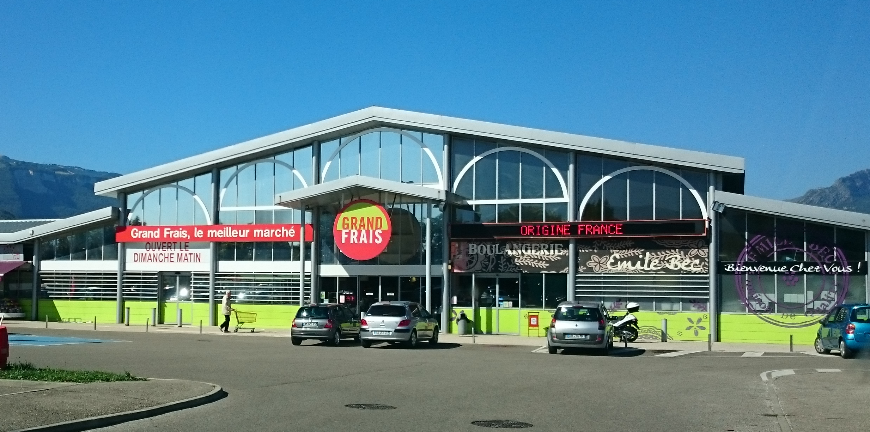
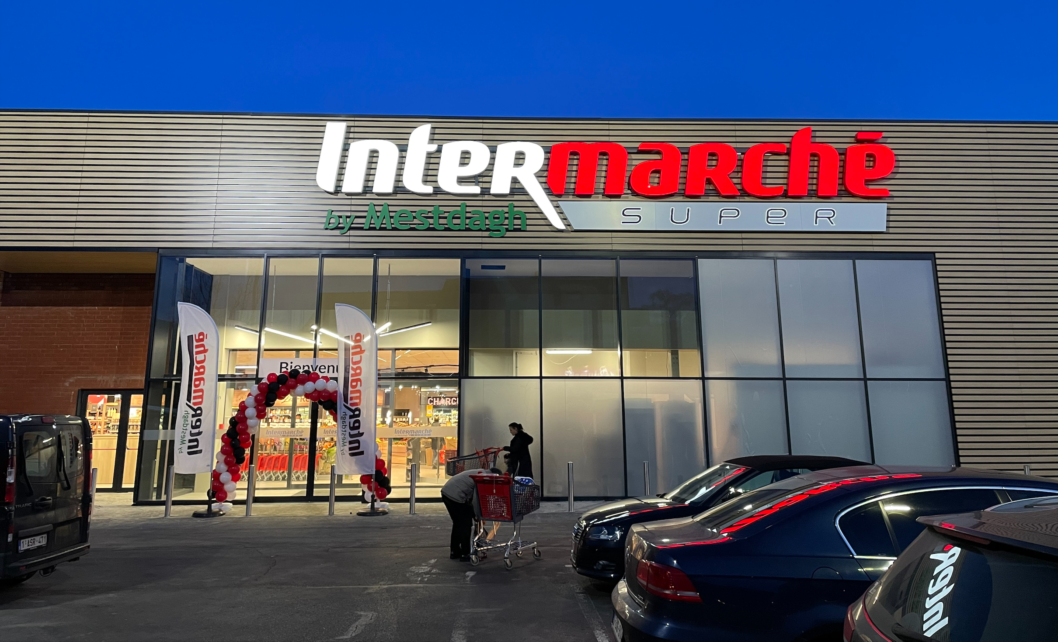
SUPERMARKETS
STRATEGIC LOCATIONS
40% OF ASCENCIO’S INCOME
Grand Frais, Echirolles (FR)
MEETING CONSUMERS’ PRIMARY NEEDS
ASCENCIO’S DNA
LIMITED IMPACT OF E-COMMERCE
Intermarché, Ottignies (BE)
WHO WE ARE

Slide 5
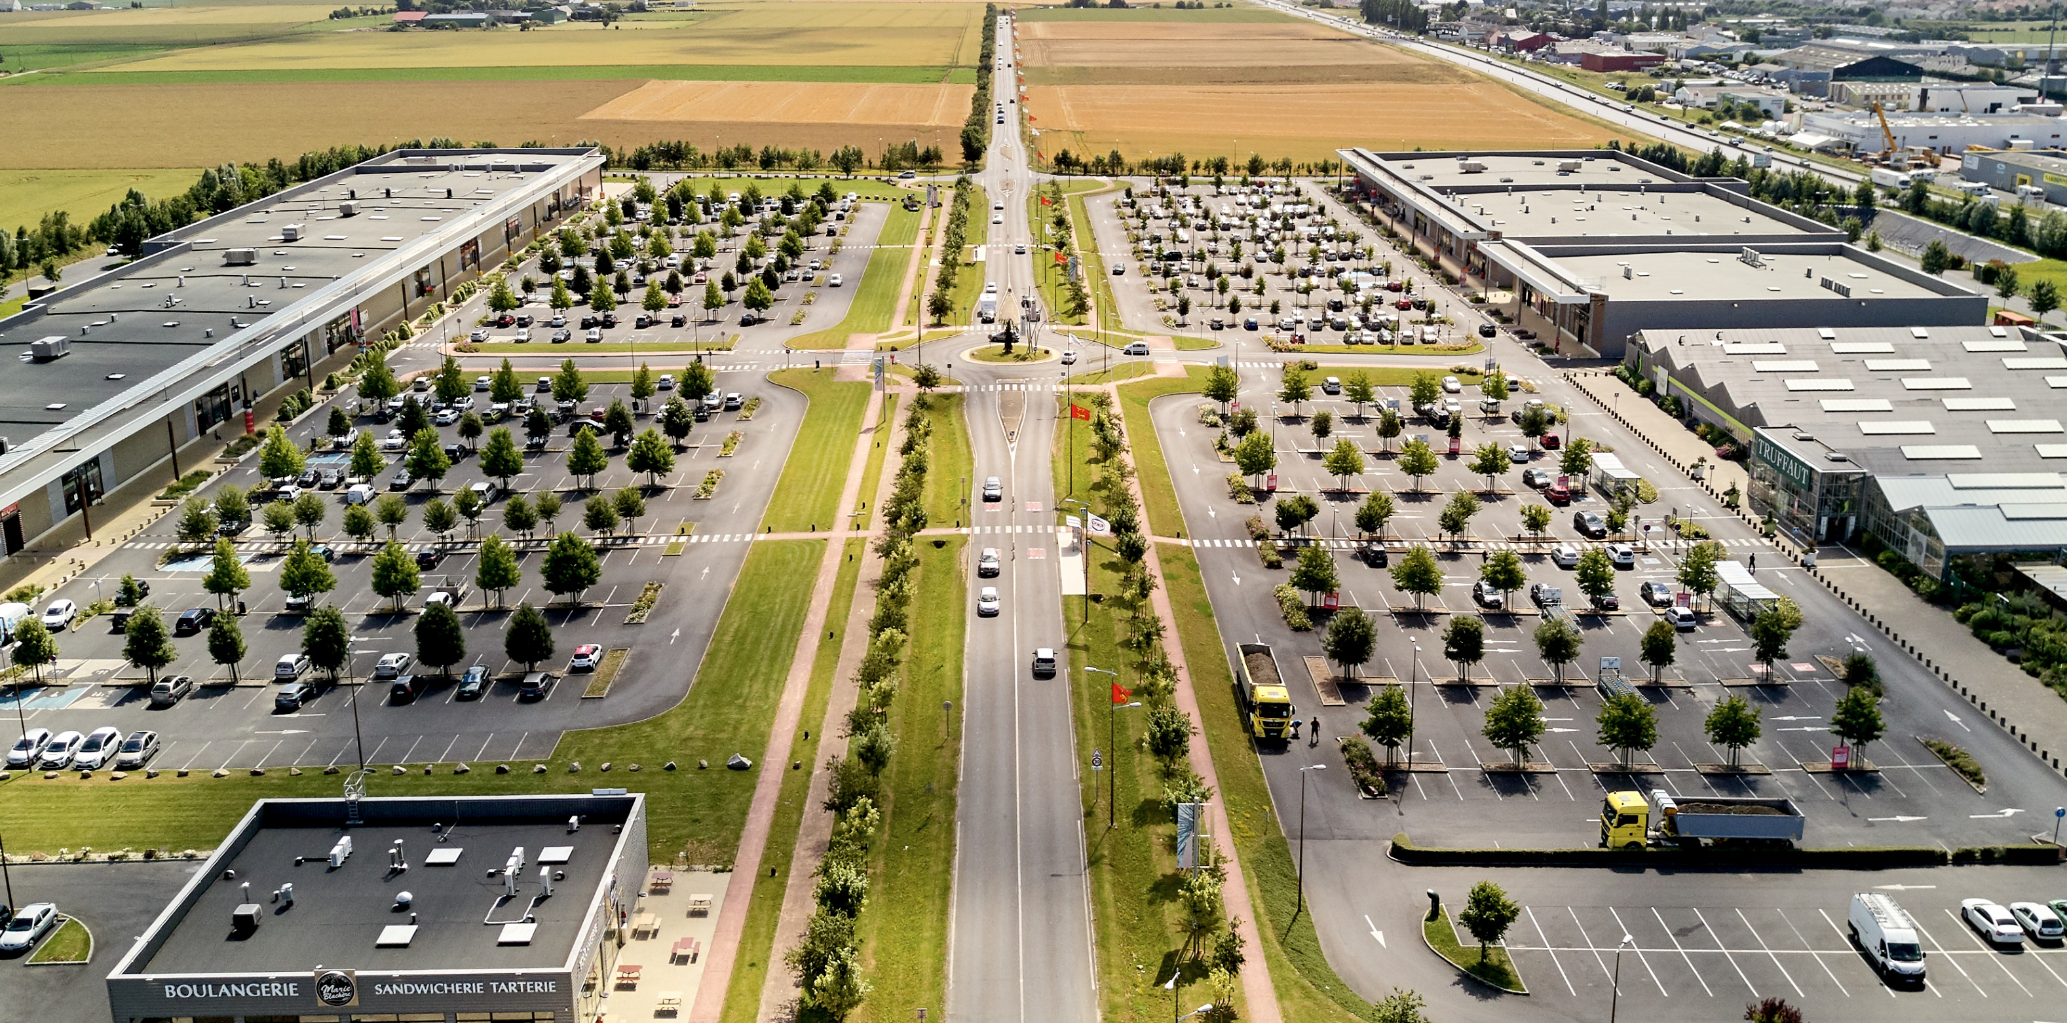
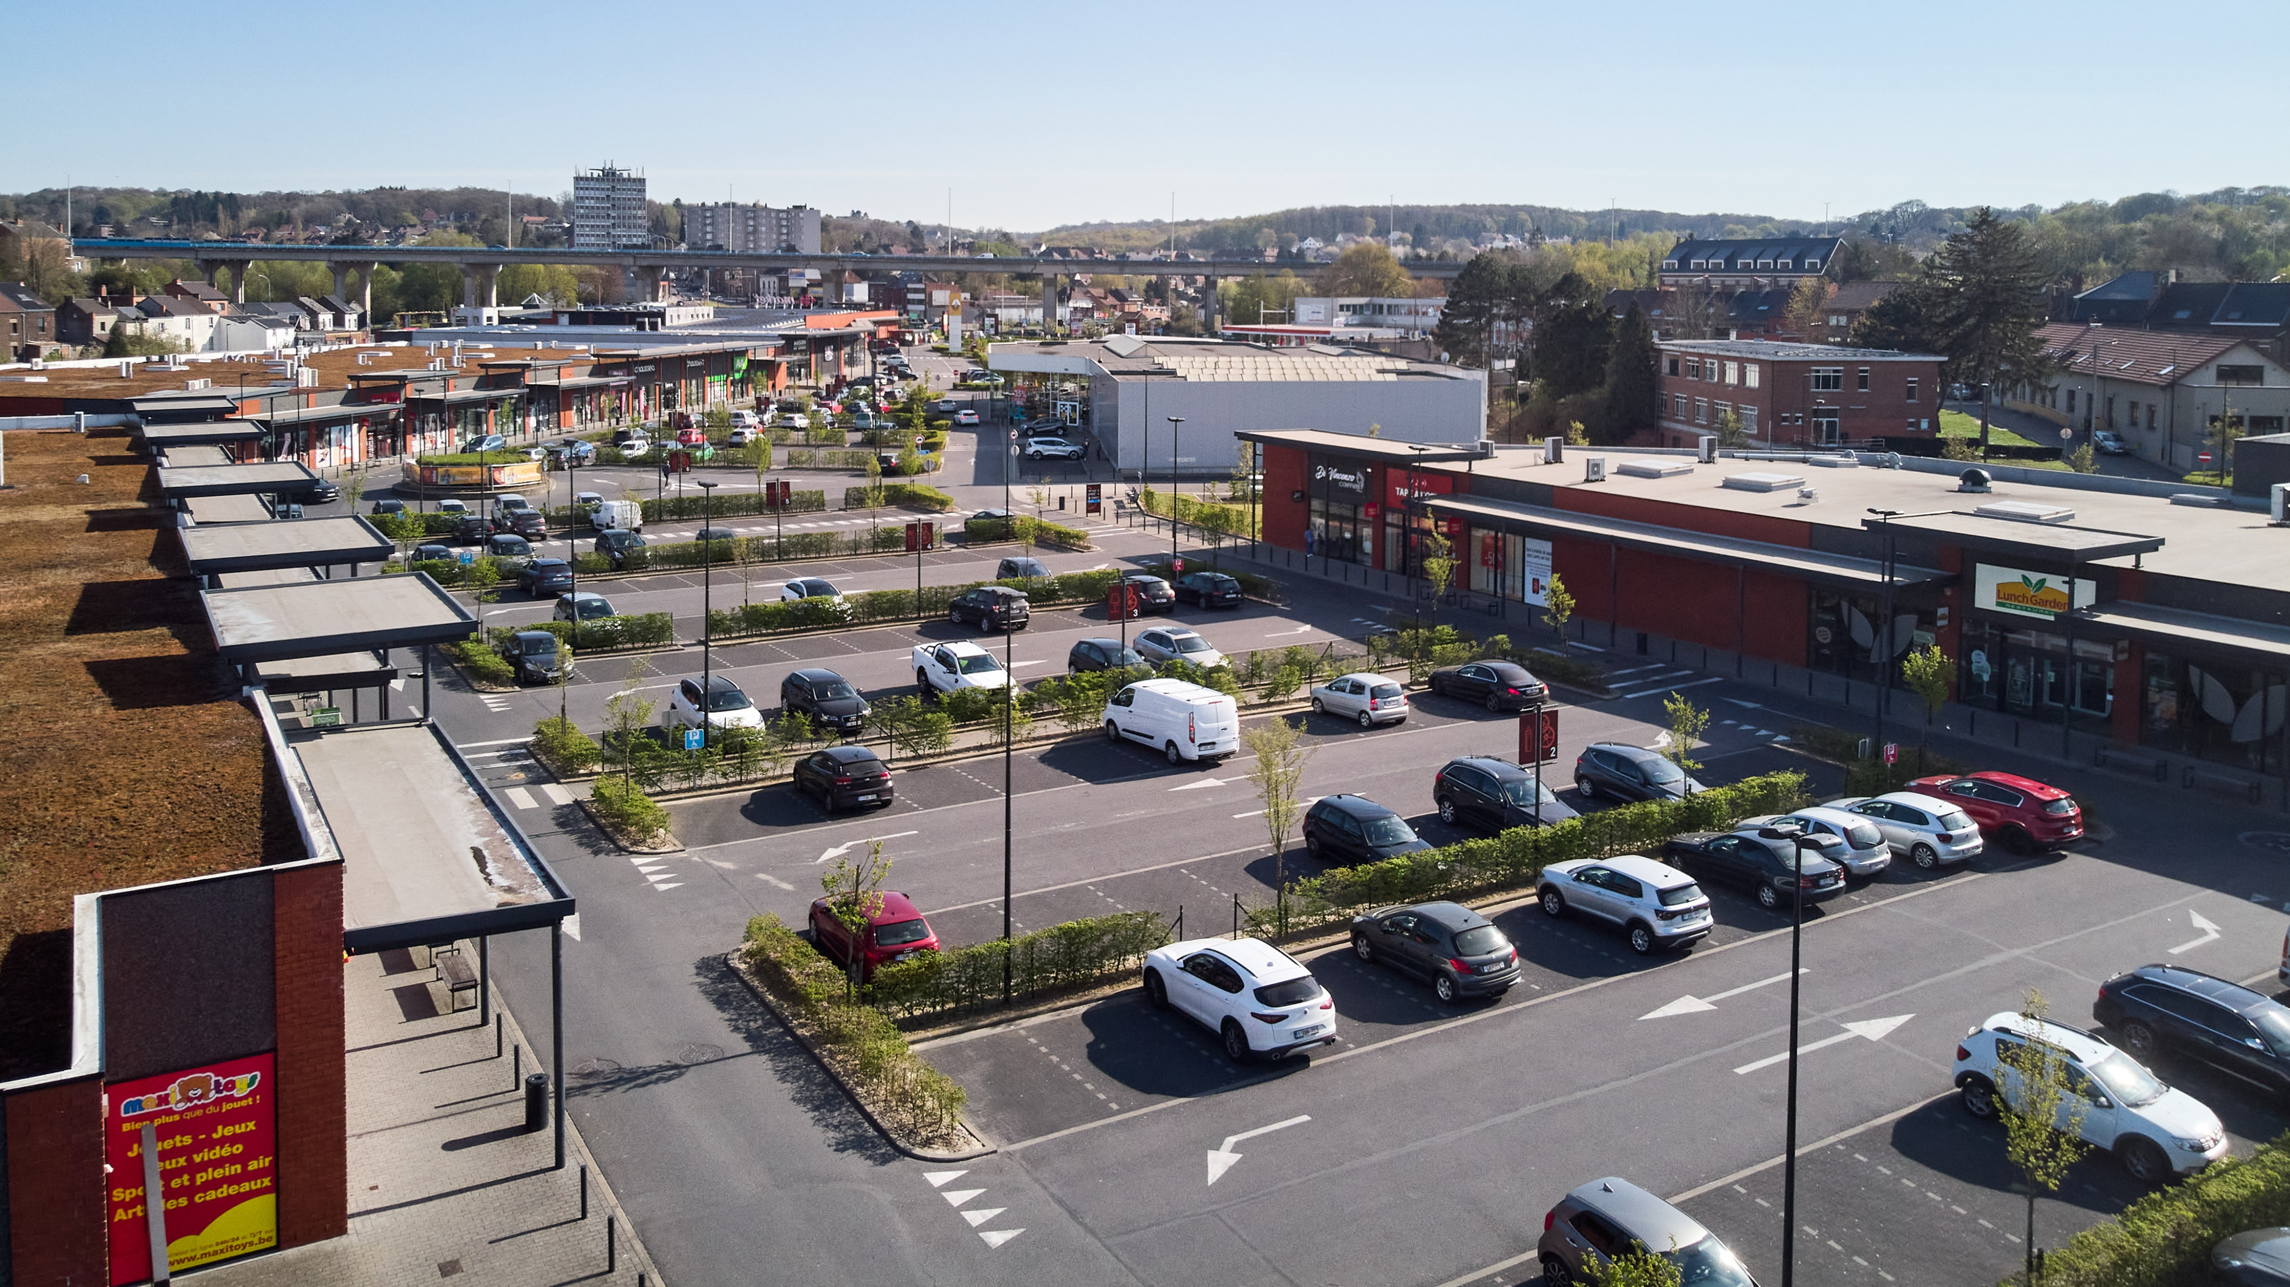
RETAIL PARKS
RETAIL MIX
PRIMARY NEEDS
Parc des Drapeaux, Caen (FR)
GOOD CONVERSION RATE
ACCESSIBILITY IN PERIPHERY
SIZE AND FLEXIBILITY OF RETAIL SPACES (OMNICANALITY)
Bellefleur, Charleroi (BE)
WHO WE ARE

Slide 6
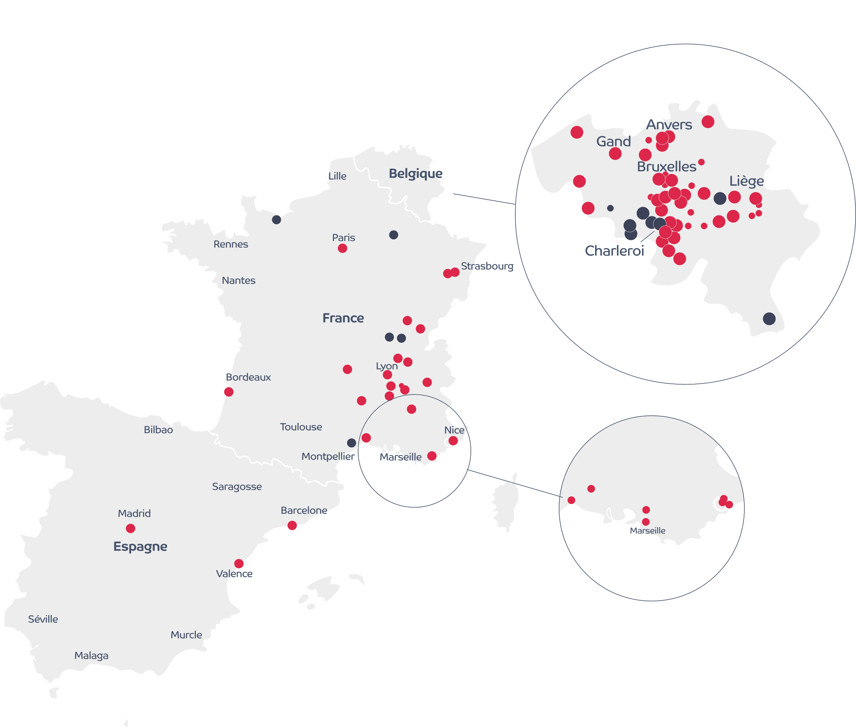
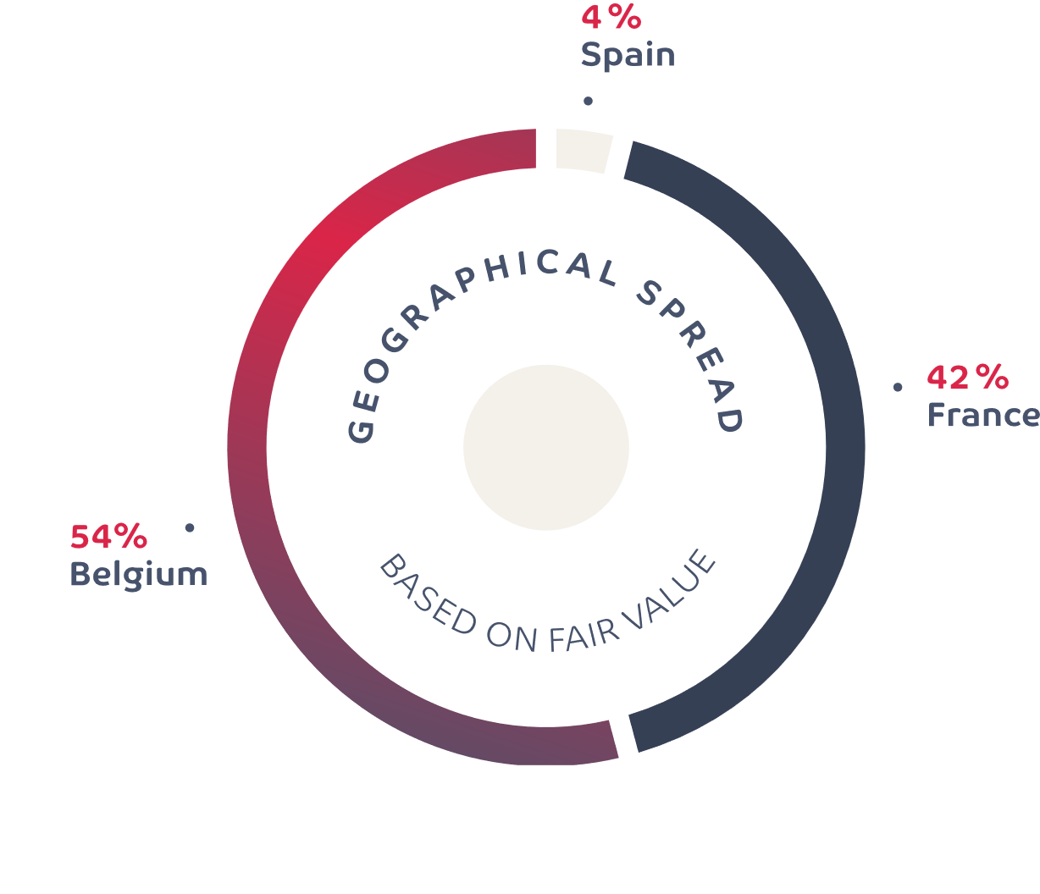
ACTIVE IN BELGIUM, FRANCE & SPAIN
Retail parks
Others
WHO WE ARE

Slide 7
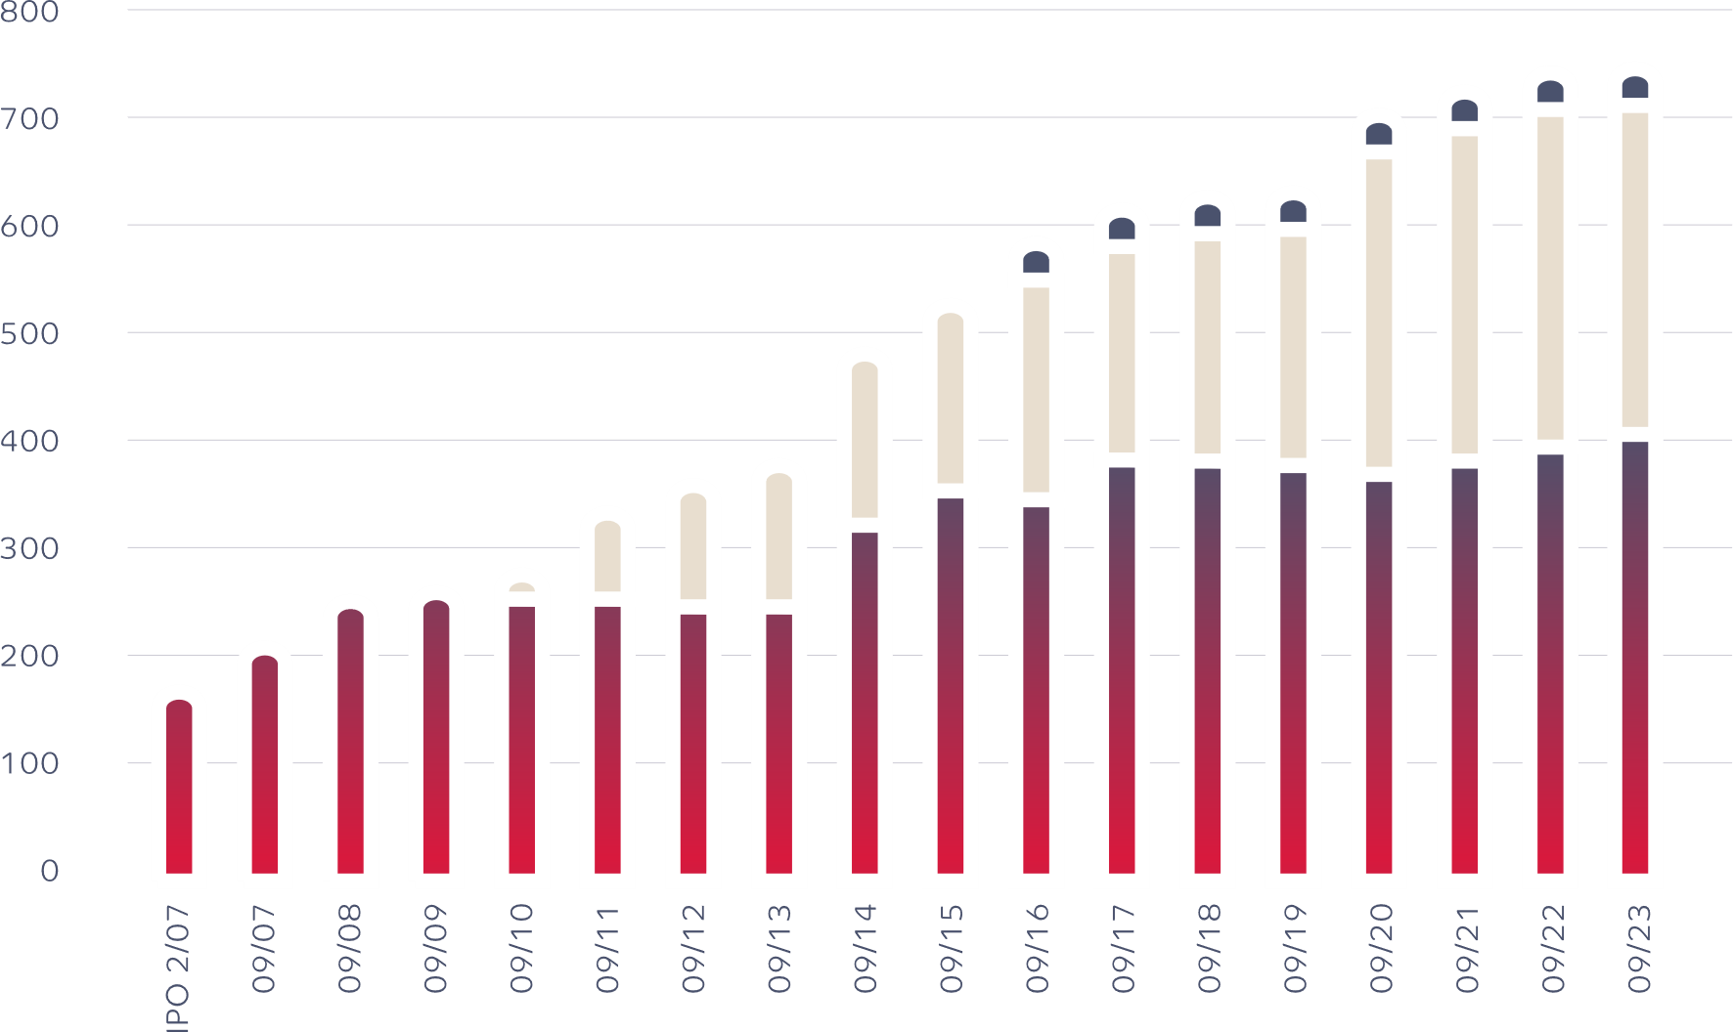
EVOLUTION OF THE PORTFOLIO
Retail properties
104
Size of portfolio
450.000 m²
Belgium
France
Spain
WHO WE ARE

Slide 8
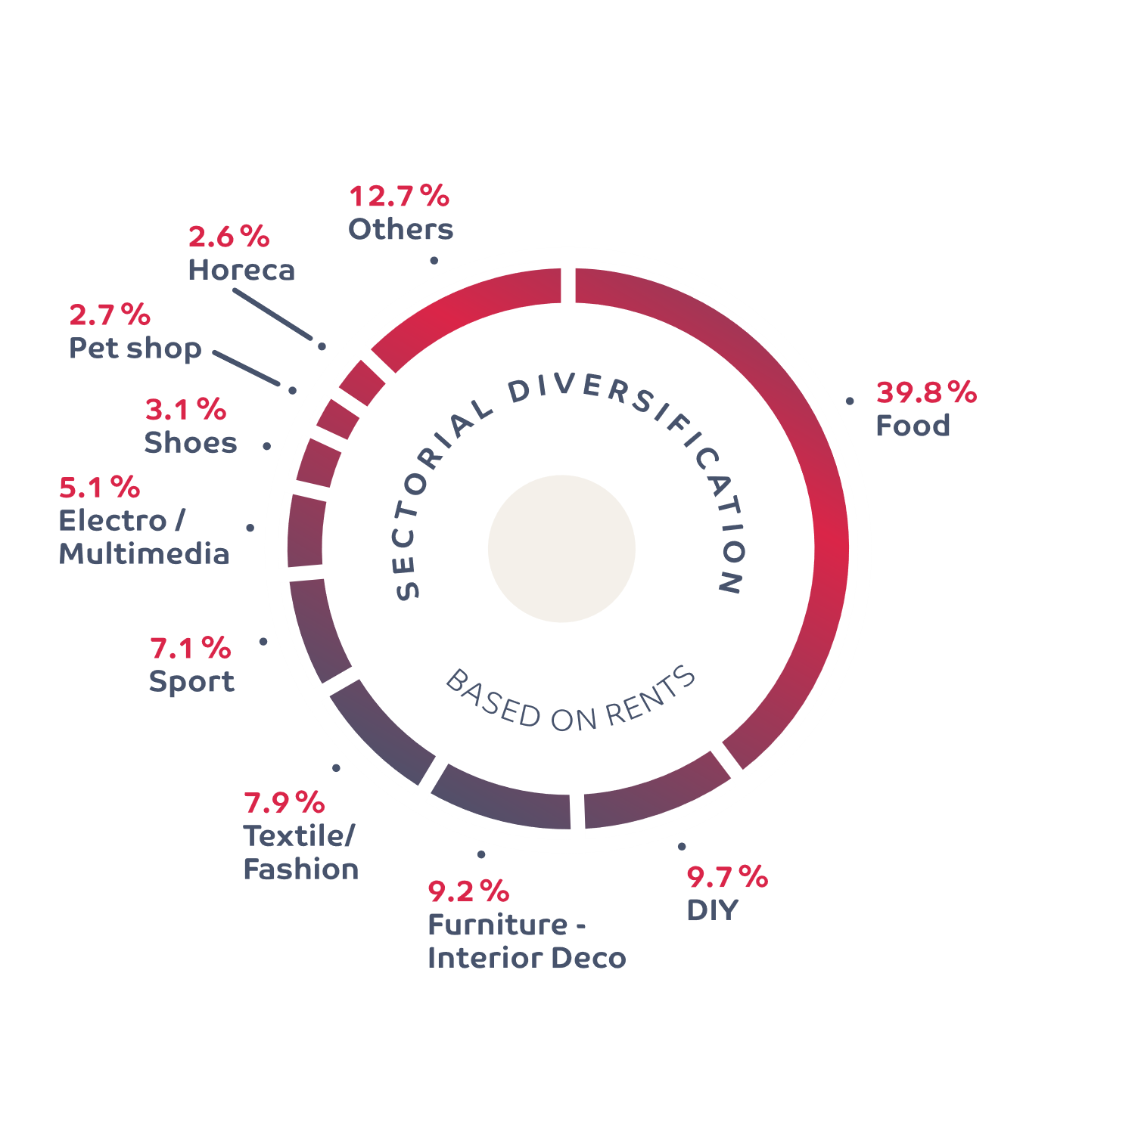
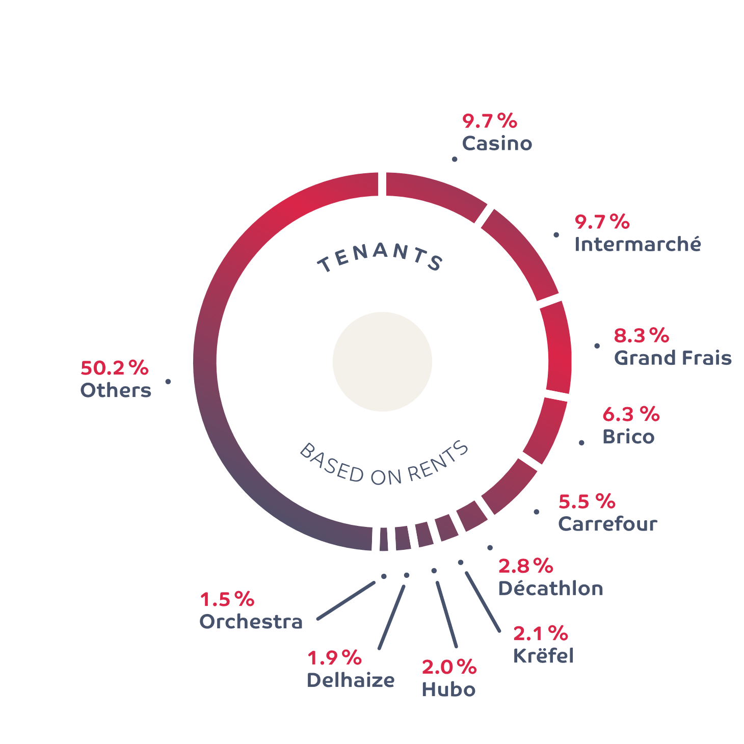
DIVERSIFICATION OF TENANTS & RETAIL SECTORS
WHO WE ARE

Slide 9
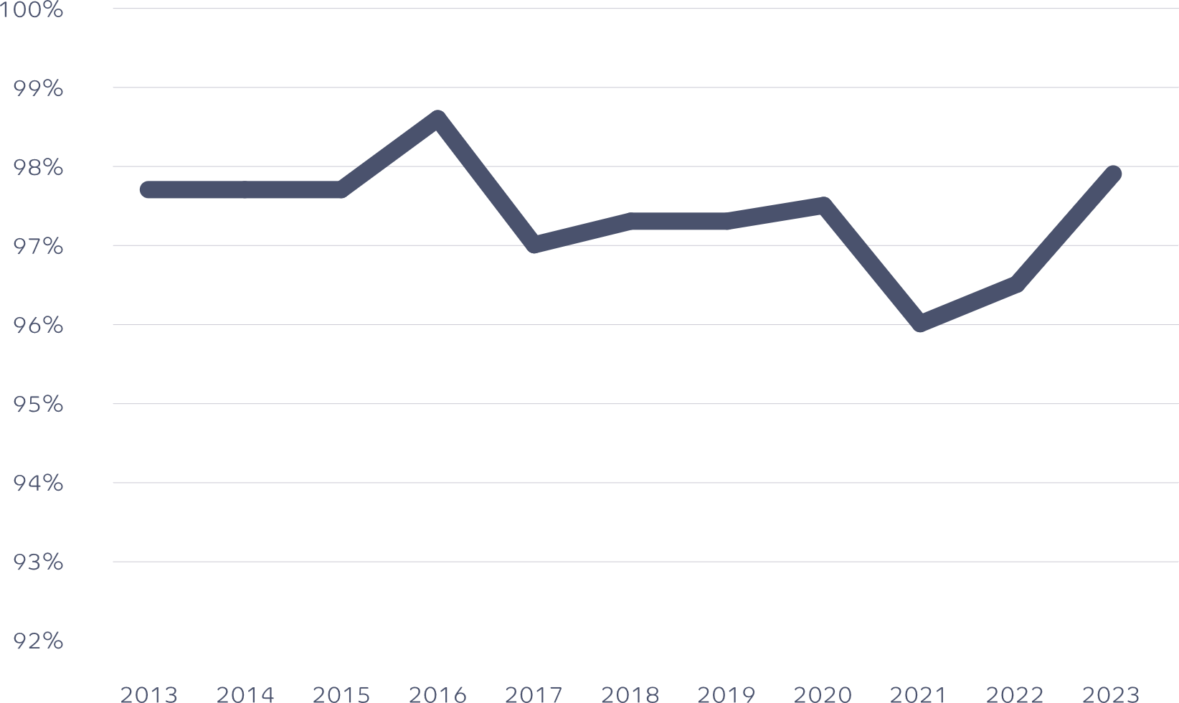
EVOLUTION OF THE OCCUPANCY RATE
97.9% at 30/09/2023
WHO WE ARE

Slide 10
CUSTOMER-CENTRIC APPROACH
Asset Management
TENANTS
Marketing & Communication
Property Management
Customer services
Operations & ESG
WHO WE ARE

Slide 11
FINANCIAL
& REAL ESTATE MARKETS
REAL ESTATES & FINANCIAL MARKETS

Slide 12
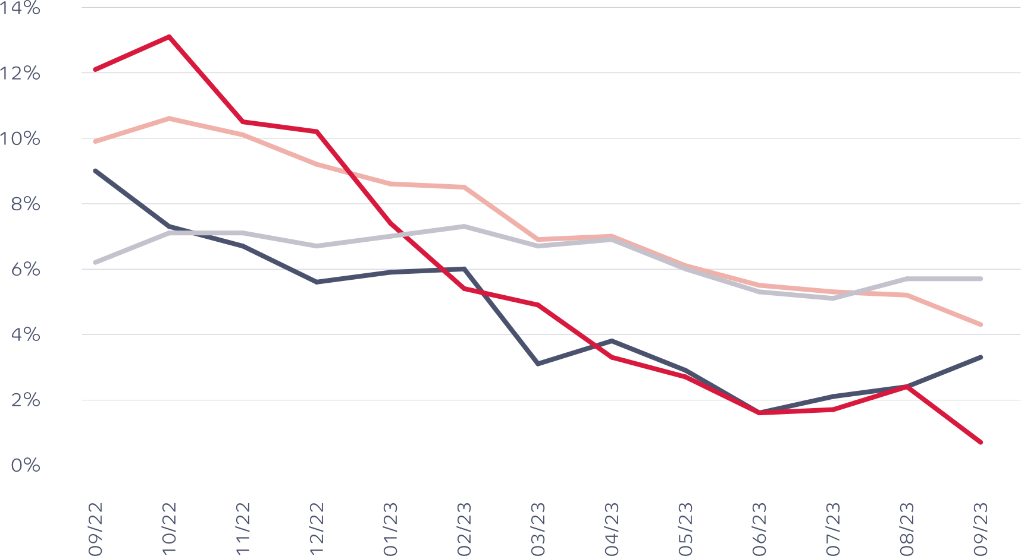
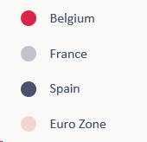
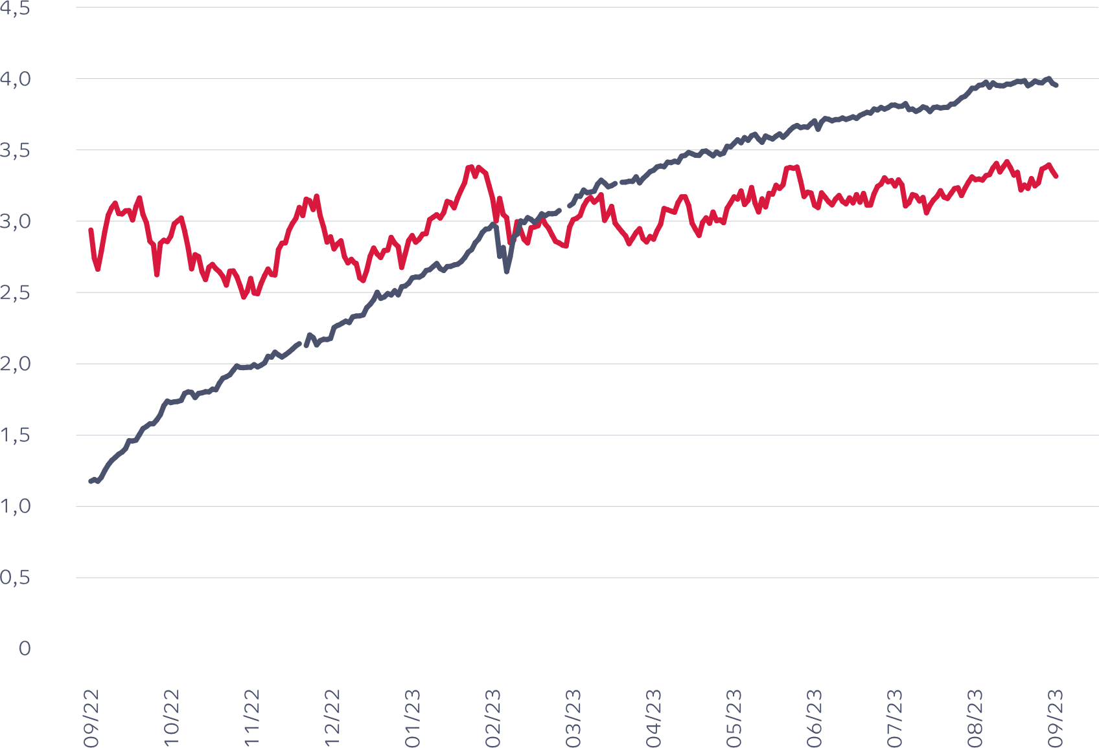
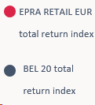
FINANCIAL MARKET
Inflation
Interest rates context
Stock market context
IRS 5 years (vs E3M)
REAL ESTATE & FINANCIAL MARKETS

Slide 13
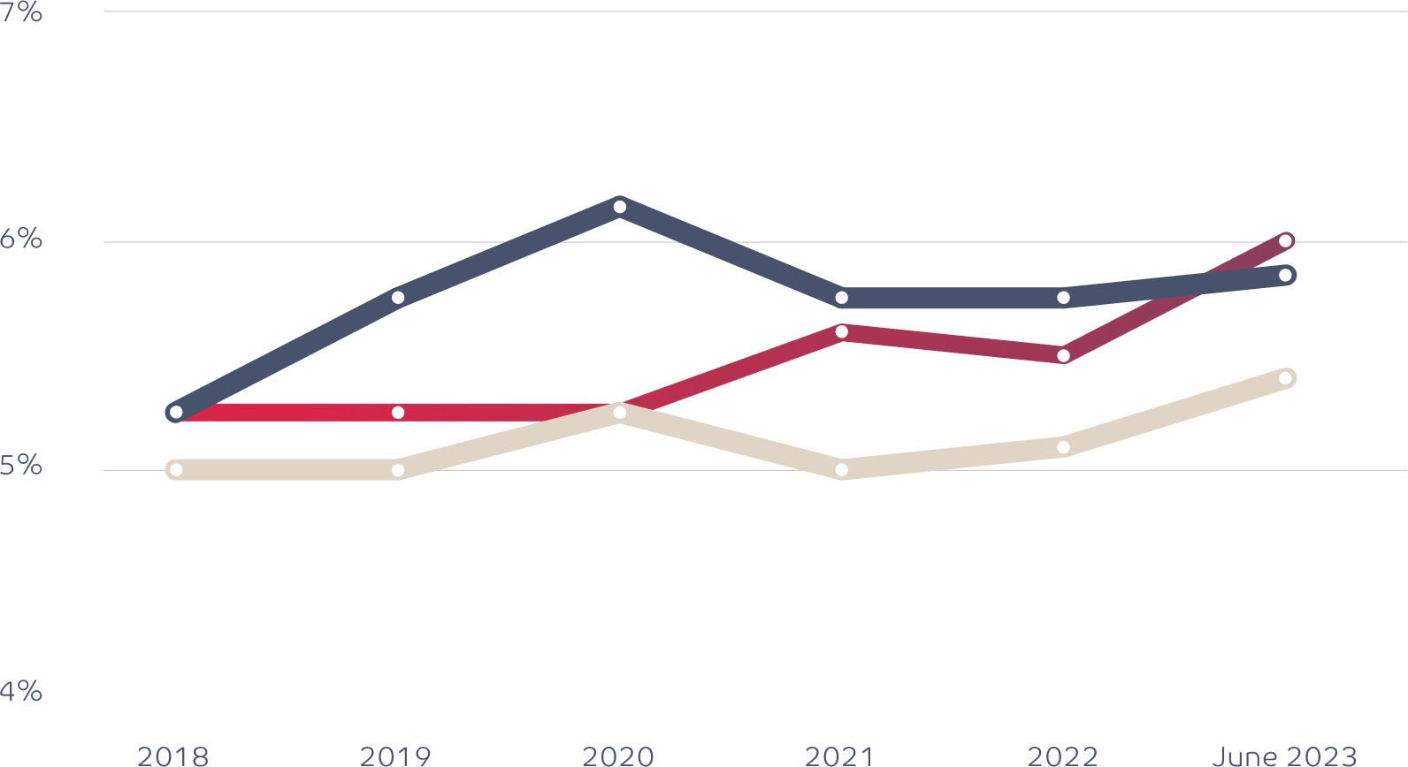
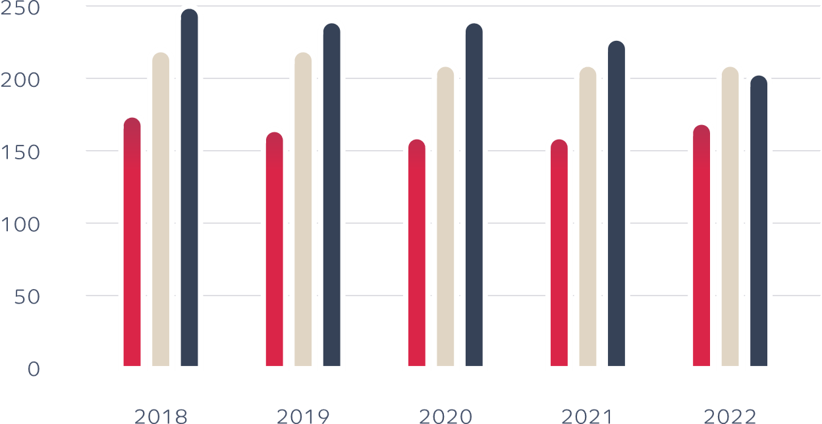
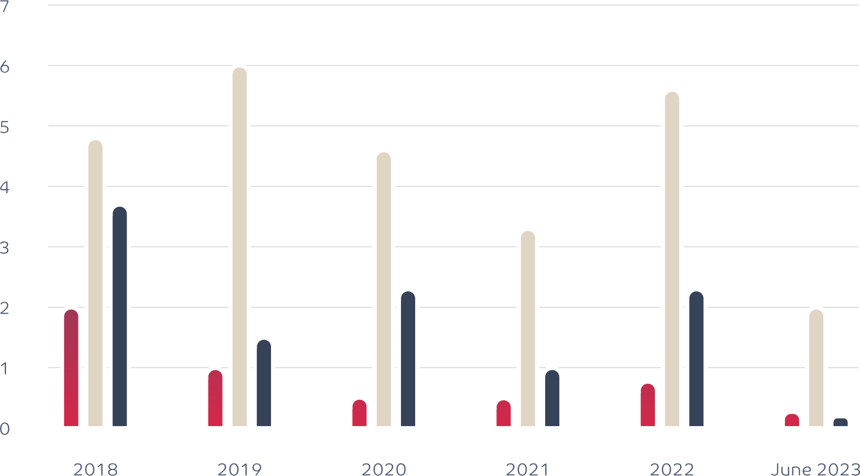
REAL ESTATE MARKET
Retail prime yields
Retail prime rents
In €/m²/year
Investment volumes
Belgium
France
Spain
In € billion
REAL ESTATE & FINANCIAL MARKETS

Slide 14
ACTIVITY SUMMARY
ACTIVITY SUMMARY

Slide 15
LETTING ACTIVITY SUMMARY
Passing rent
-1.5%
Rental level
10 new leases
+8.5%
ERV
52 leases renewed
EPRA OCCUPANCY RATE
 |  | 30/09/2023 | 30/09/2022 | ∆
Belgium |  | 96.9% | 96.1% | 0.8%
France |  | 99.0% | 98.3% | 0.7%
Spain |  | 100.0% | 83.5% | 16.5%
Total |  | 97.9% | 96.5% | 1.4%
75,000 m²
(17% of portfolio’s surface)
€8.2 million
(16% of total portfolio’s rents)
+
14
short term leases
ACTIVITY SUMMARY

Slide 16
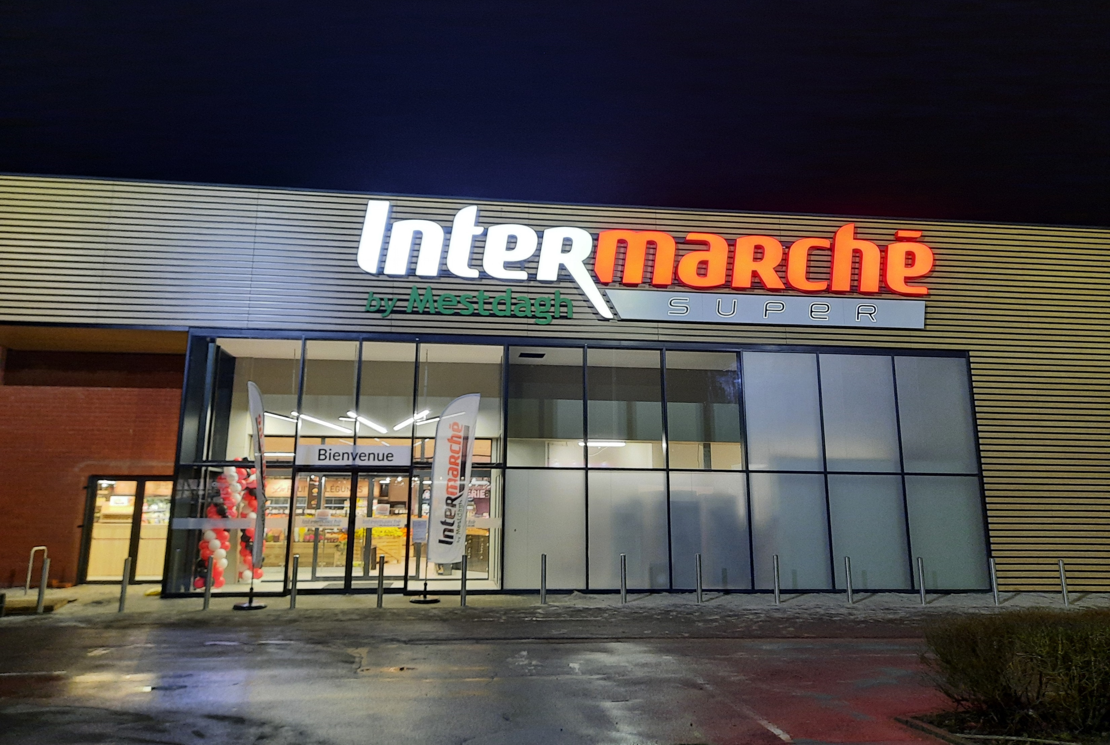
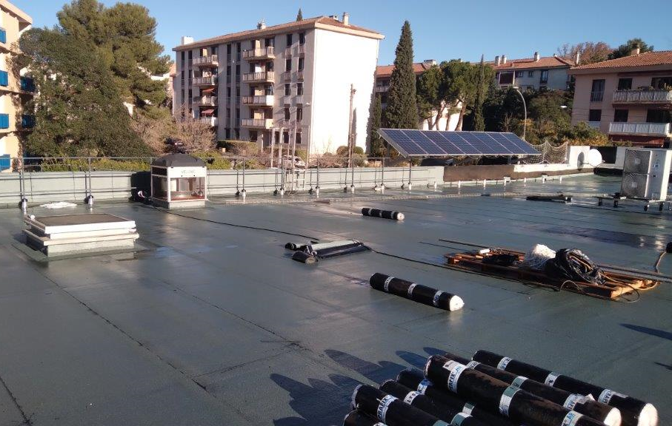
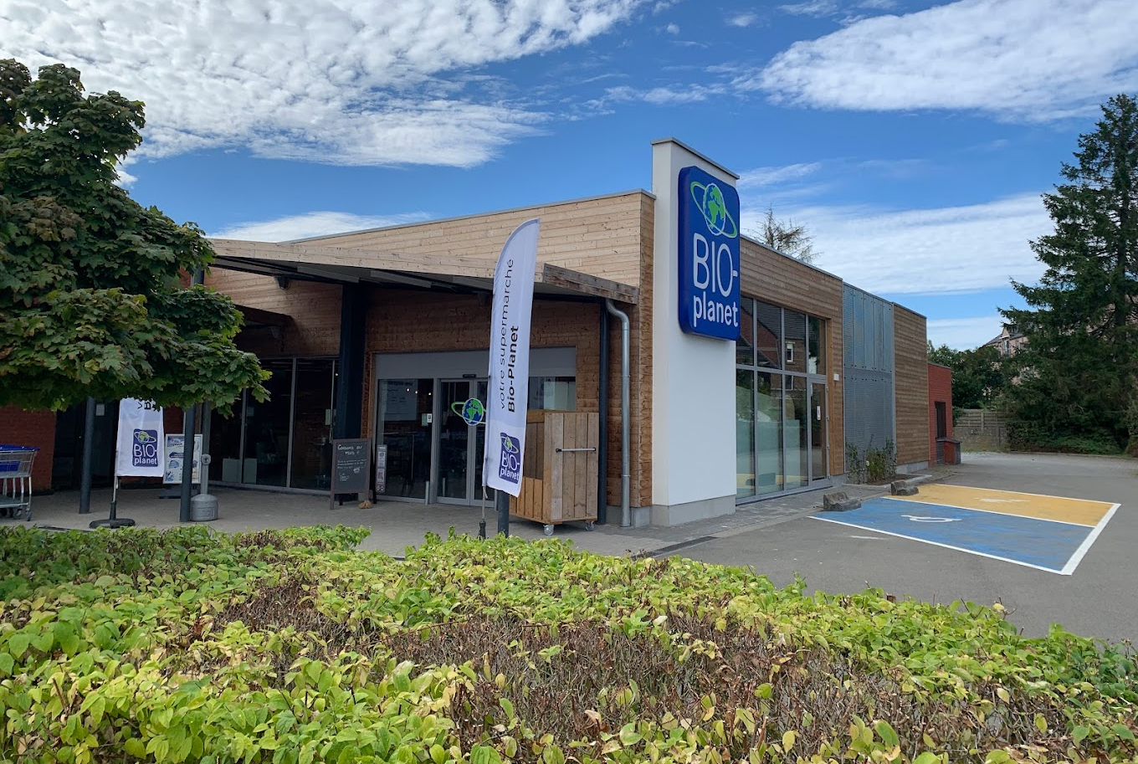
OPERATIONAL ACTIVITY
INVESTMENTS & DEVELOPMENTS
Total 2022/2023
€2.1 million
Intermarché, Ottignies (BE)
Casino, Aix-en-Provence (FR)
Bio Planet, Hannut (BE)
ACTIVITY SUMMARY

Slide 17
VALUATIONS
 | Geographical spread (30/09/2023) | Fair value (€000s) (30/09/2023) | Fair value (€000s) (30/09/2022) | Δ Fair value (invest. excl.) 2022/2023
Belgium | 54% | 404,493 | 393,826 | +2.1%
France | 42% | 305,863 | 313,936 | -2.7%
Spain | 4% | 30,500 | 30,850 | -1.1%
Total operating portfolio | 100% | 740,856 | 738,612 | -0.02%
Development projects |  | 0 | 320
Total portfolio | 100% | 740,856 | 738,933 | -0.02%
ACTIVITY SUMMARY

Slide 18
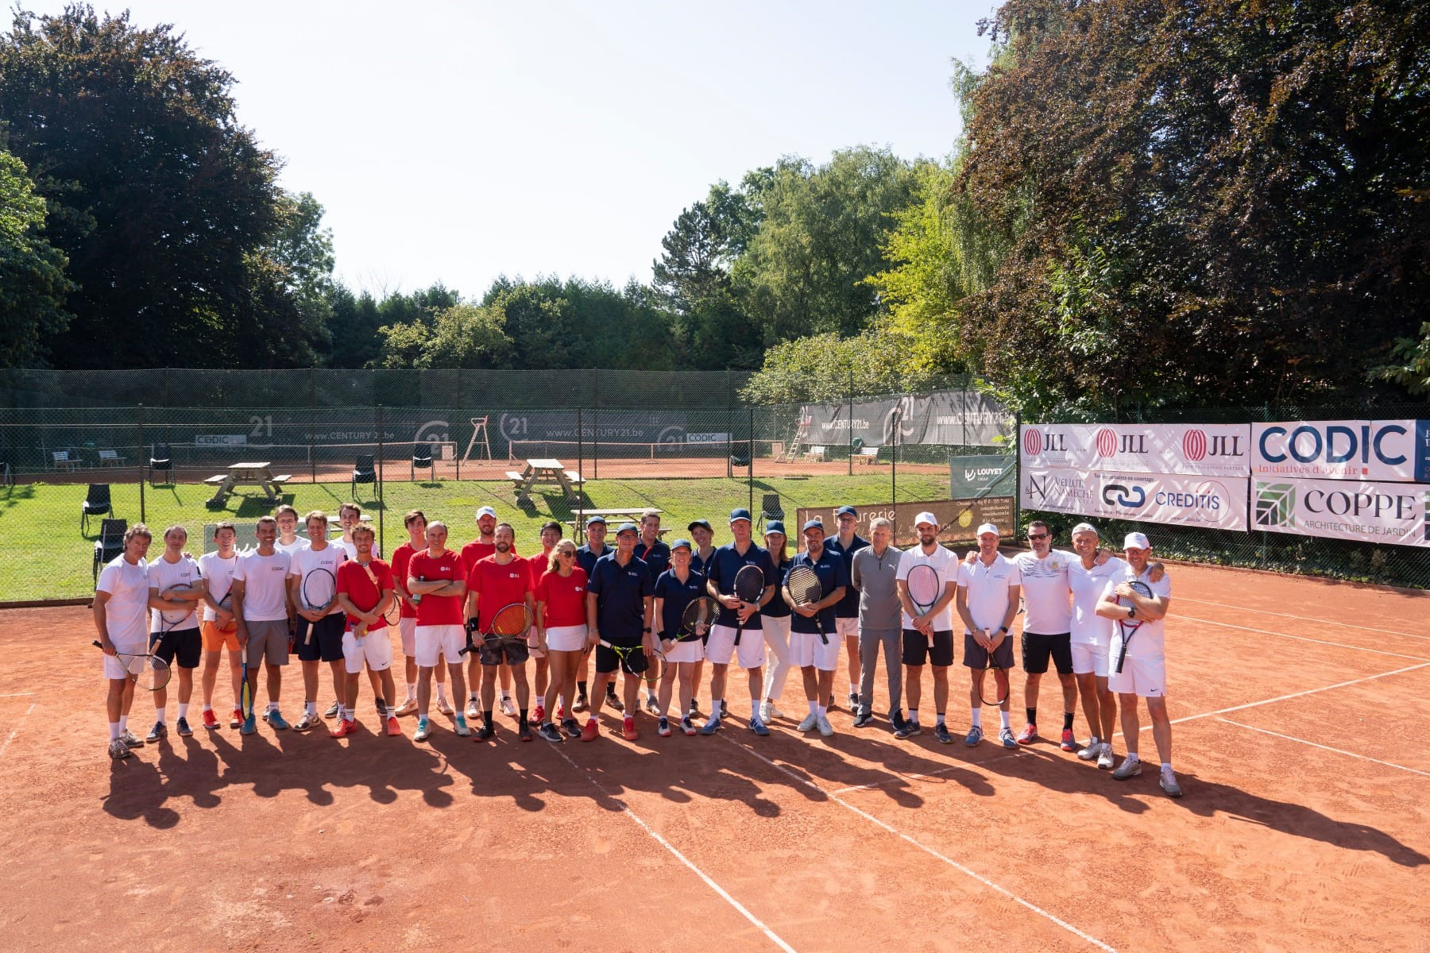
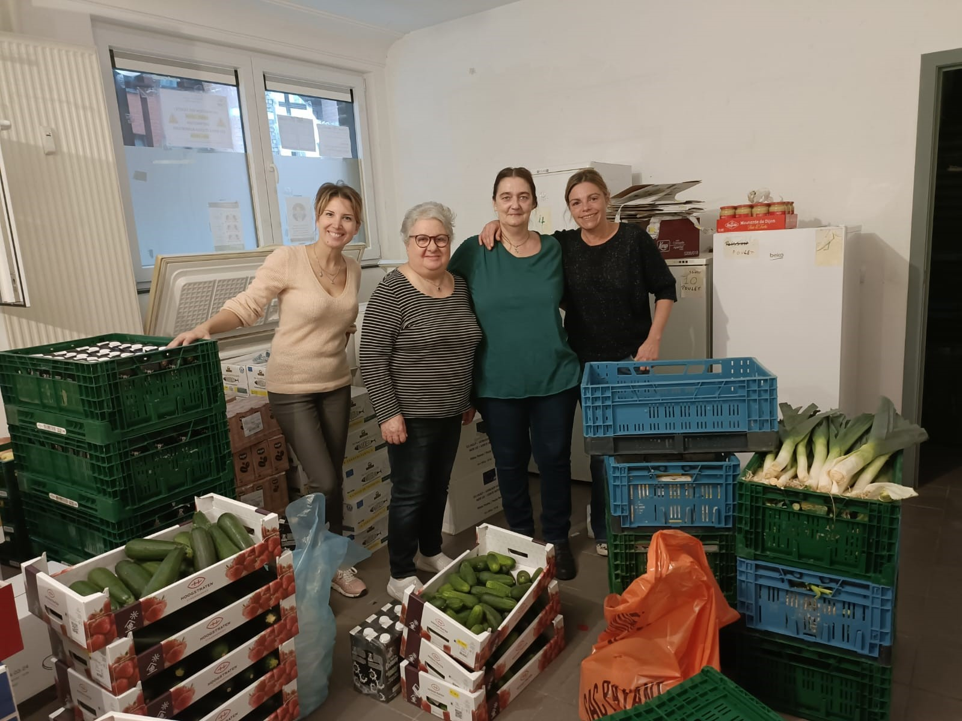
ESG ACHIEVEMENTS
Environment
Tenants consumption data collection
Green appendix to new leases
BREEAM certification
Car charging stations
Social
Training courses
Electromobility
New offices
Promoting sport & fight against hunger
Governance
sBPR reporting : gold award sBPR
A director of Operations & ESG joined the executive committee
+ DIGITALISATION PROGRAM
ACTIVITY SUMMARY

Slide 19
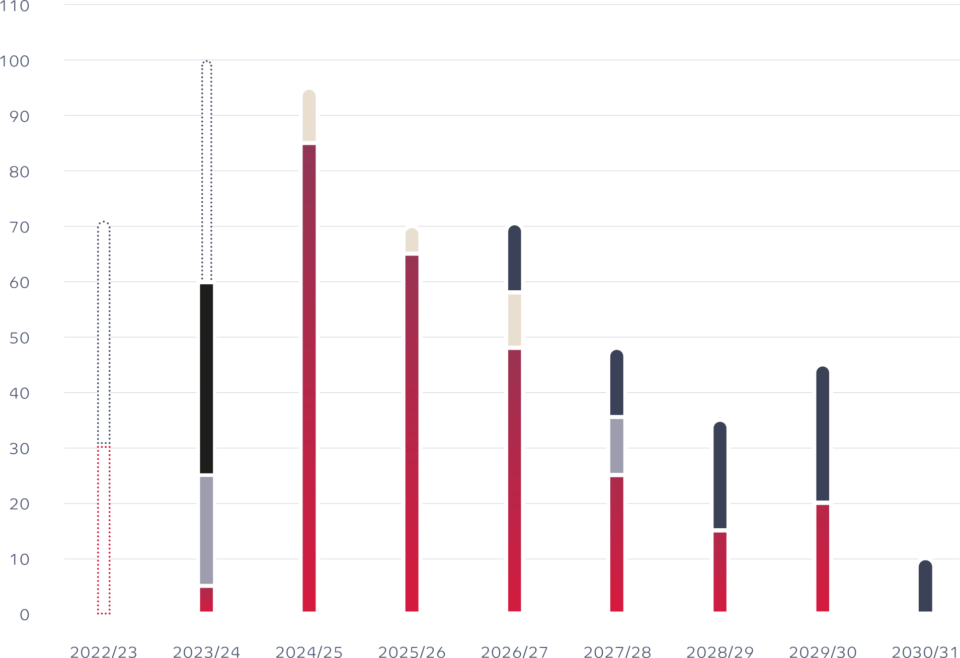
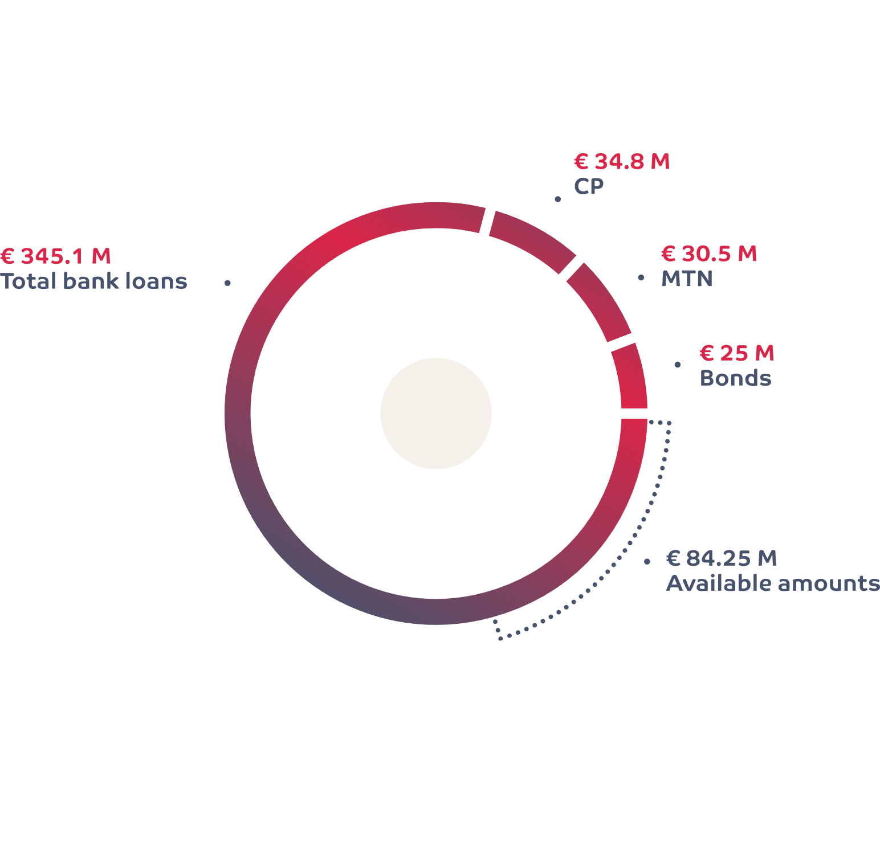
FINANCIAL ACTIVITY
DEBT MATURITIES AS OF 30/09/2023
REFINANCING 2022/2023
7 new bank credit loans
Counterparties : Belfius, BNP, CBC, CEHDF
Total nominal amount : €80 millions
Average duration new loans : 5.8 years
€ million
Bank loans
Bond
Bank loans new
MTN
Bank loans refinanced
CP
CP refinanced
Total debt duration: 3.4 years
Average cost of financing in 2022/2023: 2.02%
ACTIVITY SUMMARY

Slide 20
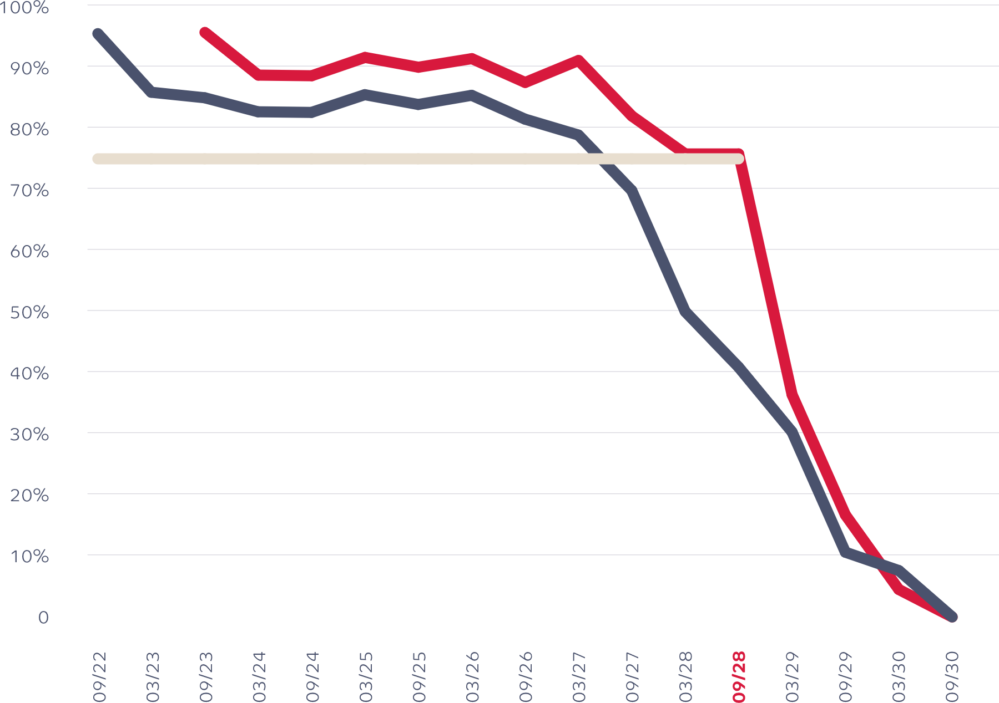
FINANCIAL ACTIVITY
HEDGE STRUCTURE AS OF 30/09/2023
Fully compliant with hedging strategy
Reduced volatility of financing costs over 5 years
HEDGING ACTIVITY 2022/2023
June 2023 : acquisition of 2 IRS
Nominal : €20 million
Period : 30/06/2023 → 31/12/2029
August 2023 : acquisition of 2 IRS
Nominal : €20 million
Period : 31/12/2026 → 31/12/2028
September 2023 : liquidation of 4 existing IRS and acquisition of 3 new IRS
nominal : >= €35 million
Period : 31/03/2025 → 30/06/2030
75%
Hedge ratio as of 30/09/2022
Hedge ratio as of 30/09/2023
Hedge strategy
ACTIVITY SUMMARY

Slide 21
FINANCIALS
FINANCIALS

Slide 22
ANNUAL CONSOLIDATED RESULTS
(€000s) | 30/09/2023 | 30/09/2022 | Δ
RENTAL INCOME | 51,322 | 47,849 | 7.3%
Rental related charges | -223 | 684
Recovery of property charges | 956 | 681
Rental related charges and taxes not recovered | -312 | -108
Other revenue and rental related charges | -26 | -239
PROPERTY RESULT | 51,716 | 48,867 | 5.8%
Property charges | -4,633 | -4,004
Corporate overheads | -4,656 | -4,482
OPERATING RESULT BEFORE RESULT ON PORTFOLIO | 42,427 | 40,381 | 5.1%
Operating margin | 82.7% | 84.4%
Financial income | 765 | 134
Net Interest charges | -6,157 | -5,710
Other financial charges | -685 | -554
Taxes | -342 | -477
EPRA EARNINGS | 36,009 | 33,773 | 6.6%
(€000s) | 30/09/2023 | 30/09/2022 | Δ
EPRA EARNINGS | 36,009 | 33,773 | 6.6%
Result on sales of investment properties | 0 | -159
Change in the fair value of investment properties | -745 | 23,800
Change in fair value of financial assets and liabilities | -1,543 | 38,135
Deferred tax | 85 | -4,896
NET RESULT | 33,806 | 90,653 | -62.7%
EPRA Earnings per share (euros) | 5.46 | 5.12
Net result per share (euros) | 5.13 | 13.74
Number of shares | 6,595,985 | 6,595,985
FINANCIALS

Slide 23
YEAR-END BALANCE SHEET
 | 30/09/2023 | 30/09/2022
Total balance sheet (€ million) | 786.5 | 783.3
Total portfolio (€ million) | 740.9 | 738.9
Total equity (€ million) | 444.8 | 437.0
IFRS NAV (€/share) | 67.43 | 66.25
EPRA NTA (€/share) | 63.59 | 62.35
Total debt (€ million) | 320.5 | 326.7
Debt Ratio | 44.0% | 44.9%
EPRA LTV | 43.4% | 44.4%
FINANCIALS

Slide 24
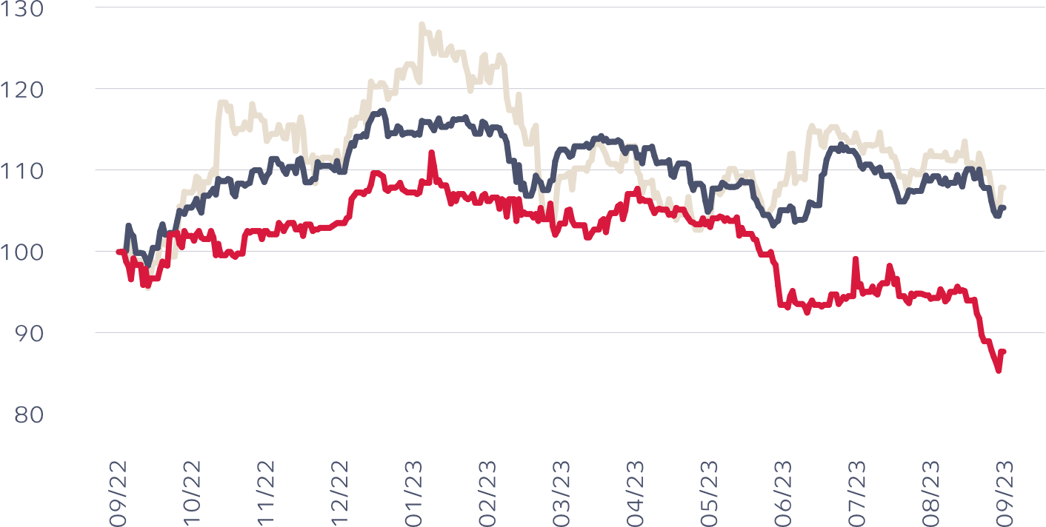
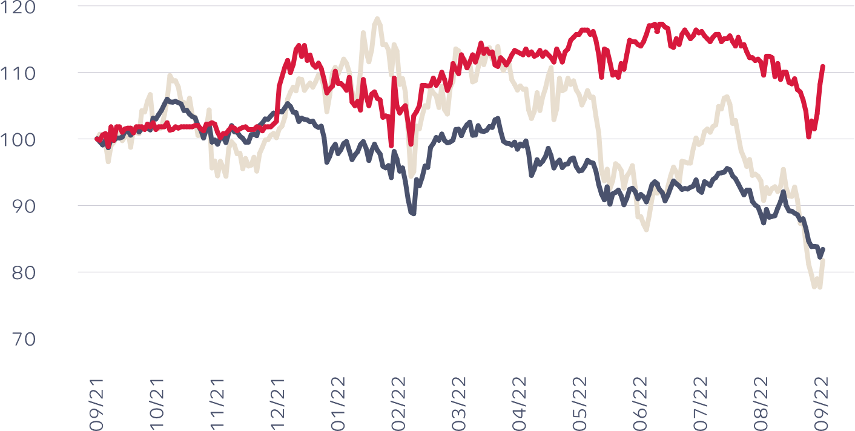
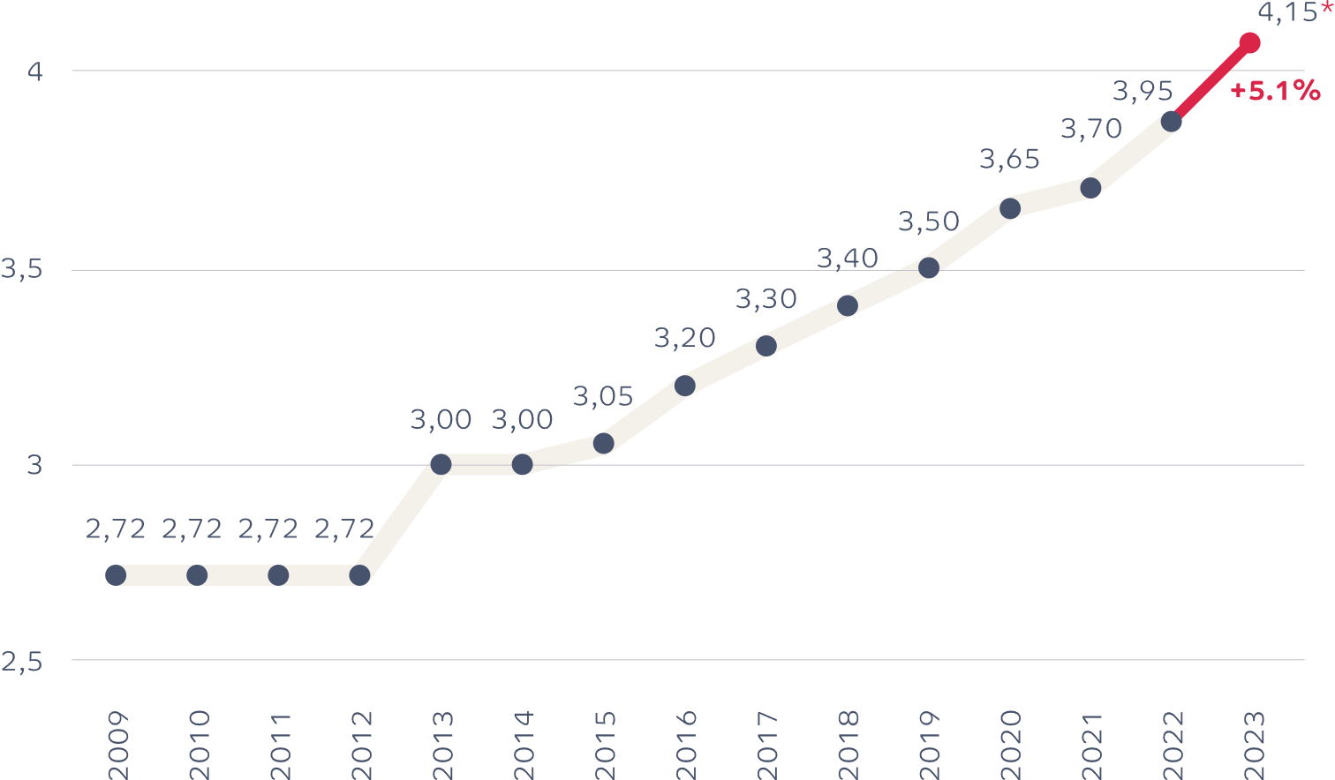
SHARE PRICE & DIVIDEND POLICY
 | 30/09/23 | 30/09/22
Closing Price | 41.30€ | 50.70€
Premium/discount (EPRA NTA) | -38.8% | -23.5%
Market cap (€ million) | 272.4 | 334.4
Dividend per share | 4.15* | 3.95
Dividend yield | 10%* | 7,8%
2022-2023
* Dividend proposed at the AGM
2021-2022
EPRA Retail Europe total return index
BEL 20 total return index
Ascencio total return index
Pay-out ratio : 78.0%
FINANCIALS

Slide 25
OUTLOOK
OUTLOOK

Slide 26
Stick to its strategic vision
Proactive portfolio management
Customer-centric approach
Selective investment policy
Developing a team of highly qualified professionals
Preservation of a strong balance sheet structure
& sufficient liquidity
OUTLOOK

Slide 27
Q & A
Q & A

Slide 28
APPENDIX
APPENDIX

Slide 29
HISTORY
2006 Creation of Ascencio
2007 Ascencio is listed on Euronext Brussels
2010 Acquisition of 7 Grand Frais
2011 Acquisition of 2 retail parks in France (« Le parc des Bouchardes » and « Le Parc des Cyprès »)
2012
Contribution in kind (€2.4 million new equity)
Acquisition of a retail park in France (« Le Parc des Drapeaux »)
2013 Acquisitions:
30 retail units near the Cora shopping centers in Belgium
A retail park in France (« Les Portes du Sud »)
2014 Capital increase of €81.5 million
2015 Acquisition of a retail park in Belgium (« Bellefleur »)
2016 Acquisitions:
A retail park in Belgium (« Les Papeteries de Genval »)
3 units in Spain
2020 Acquisition of 5 Casino supermarkets in France
2023 Takeover of the Mestdagh supermarkets by Intermarché
APPENDIX

Slide 30
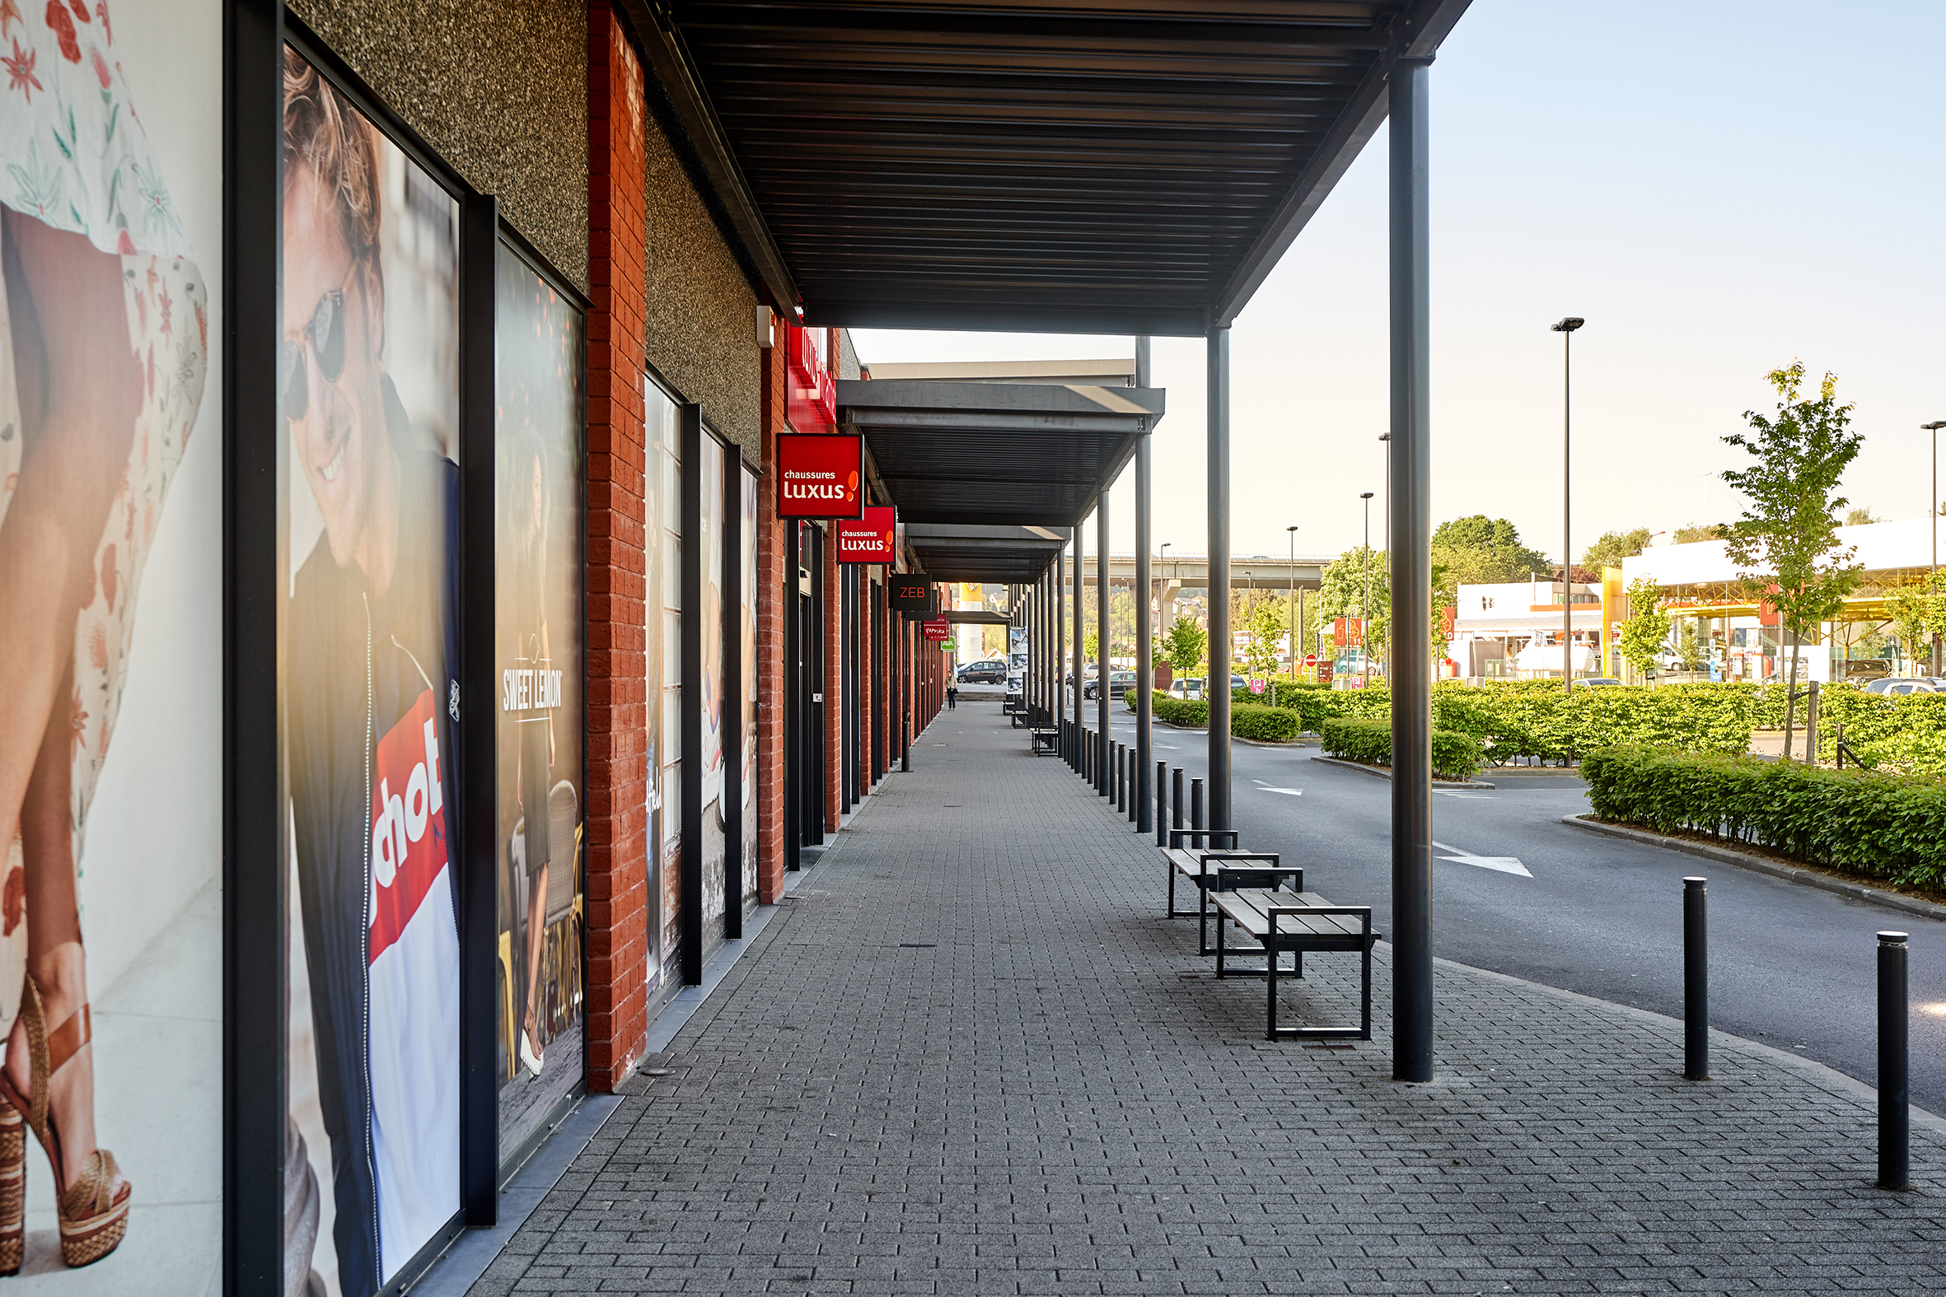
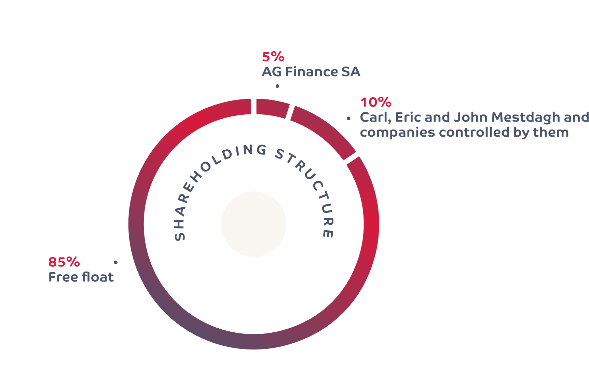
SHAREHOLDING STRUCTURE
APPENDIX

Slide 31
STATUS
SIR/GVV (Belgium)
Risk diversification (20%)
Limitation of debt (65%)
Obligation of distribution (80%)
Tax transparency
Control by the FSMA
Free float (min 30%)
SIIC (France)
No limitation of debt
Tax transparency
Obligation of distribution:
95% of net rental income
70% of capital gains
100% of dividend from subsidiaries
5% withholding tax on profits according to BE-FR directive
SOCIMI (Spain)
Identification of shareholder’s structure (> 95%)
At least 80% of eligible assets
At least 80% of rental income
No diversification limitation
Holding period of at least 3 years
No minimum obligation of distribution but special tax on undistributed profits
No withholding tax on profits according to BE-SP directive
APPENDIX

Slide 32
Consolidated balance sheet
CONSOLIDATED BALANCE SHEET (€000s) | 30/09/2023 | 30/09/2022
ASSETS | 786,469 | 783,312
Intangible assets | 236 | 24
Investment properties | 740,856 | 738,933
Other tangible assets | 49 | 35
Other non-current assets | 30,670 | 31,514
Current financial assets | 867 | 885
Trade receivables | 5,556 | 4,956
Cash and cash equivalents | 5,423 | 4,356
Other current assets | 2,811 | 2,611
EQUITY AND LIABILITIES | 786,469 | 783,312
Equity | 444,763 | 437,011
Non-current financial debts | 262,670 | 268,677
Other non-current liabilities | 2,806 | 2,476
Deferred tax | 6,085 | 6,170
Current financial debts | 57,829 | 58,038
Other current liabilities | 12,316 | 10,939
IFRS NAV (€/share) | 67.43 | 66.25
EPRA NTA (€/share) | 63.59 | 62.35
Debt ratio (in accordance with the Royal Decree) | 44.0% | 44.9%
EPRA LTV | 43.4% | 44.4%
APPENDIX

Slide 33
ESG STRATEGY
ASCENCIO’S ESG STRATEGY
Environment
Labelling
Decision-making criteria
Database & management platform
Optimising energy performance
Photovoltaic panels
Charging stations
Supplier & Tenants charters
Social
Training
Internal satisfaction survey
Positive office
Telework policy
Mobility
Social & philanthropic policy
Governance
Governance structure
Remuneration policy
Communication of ESG standards
+ DIGITALISATION PROGRAM
APPENDIX

Slide 34
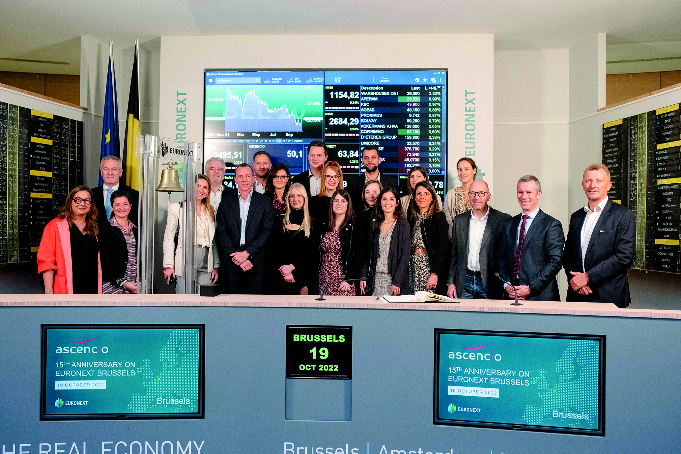
ASCENCIO TEAM
Number of employees: 21
13 women
8 men
Average age of employees : 41 years
APPENDIX

Slide 35
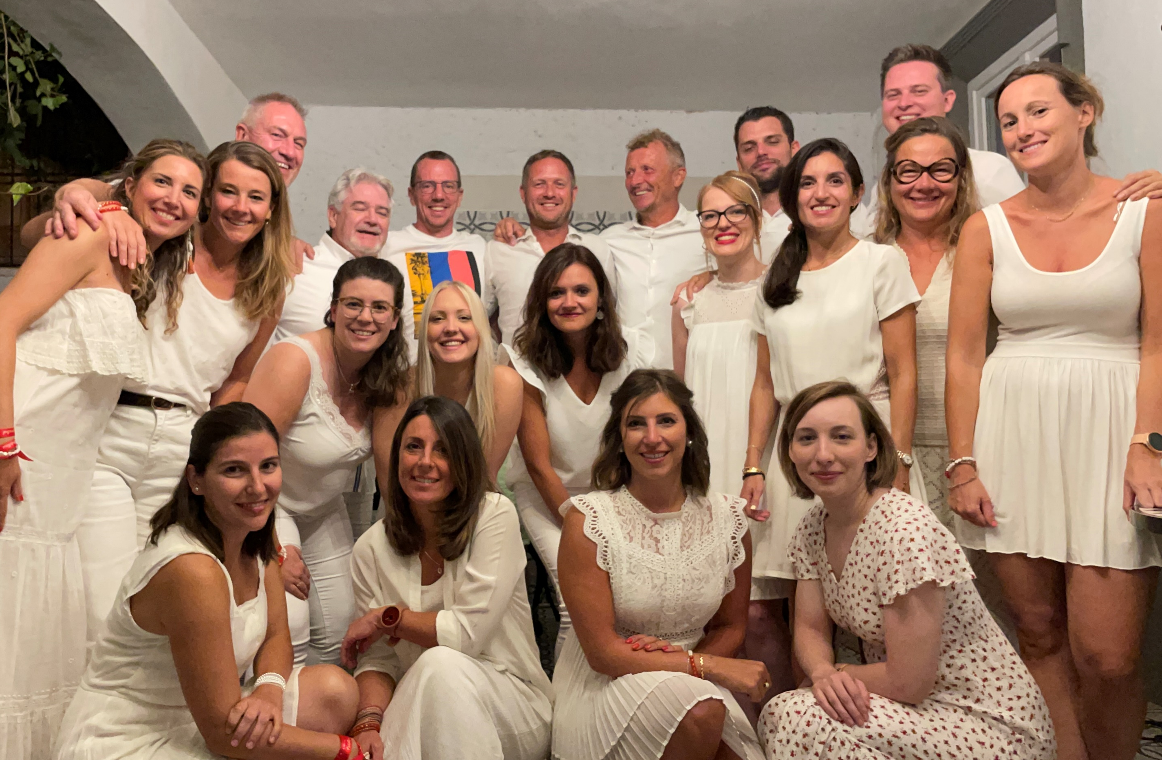
COMPANY VALUES
“Connected” with our customers, our employees, our partners, our markets
“Ambition” to grow, while respecting market cycles
“Positive Mind” Because our projects and adventures are always more attractive thanks to the positive energy brought to them by our talented team
APPENDIX

Slide 36
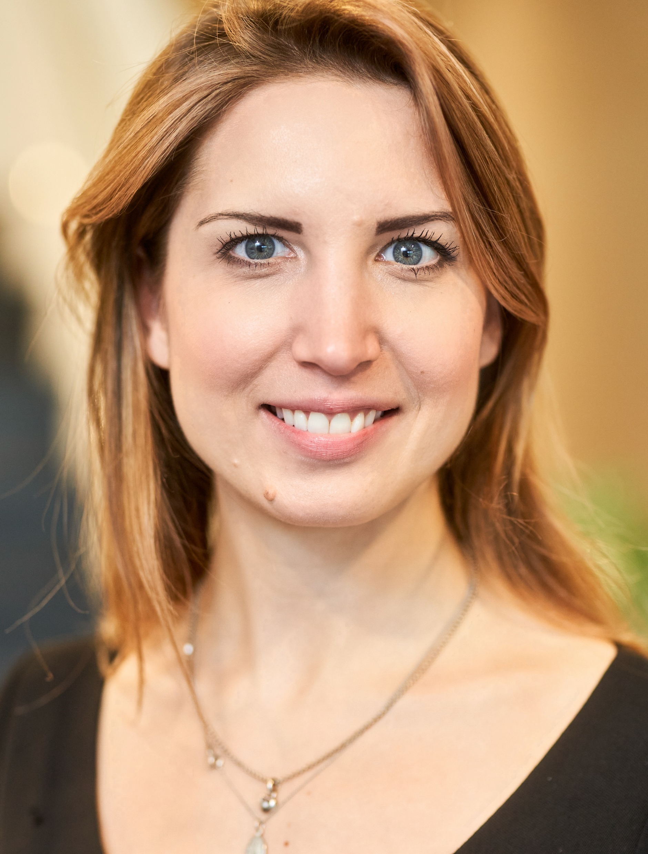
CONTACTS
Vincent H. Querton
Chief Executive Officer
+32 71 91 95 00
Cédric Biquet
Chief Financial Officer
cedric.biquet@ascencio.be
+32 71 91 95 00
Aurore Anbergen
Head of IR, Marketing & Communication
aurore.anbergen@ascencio.be
+32 71 91 95 23
APPENDIX

Slide 37
Ascencio SA
Avenue Jean Mermoz, 1/4
6041 Gosselies
-
aurore.anbergen@ascencio.be
+32 (0) 71 91 95 23
www.ascencio.be
www.instagram.com/ascencio_reit
www.linkedin.com/company/ascencio-sca/

